Slide 1

JOIN OUR JOURNEY WITH SOLUM
August, 2023

Slide 2
T A B L E O F C O N T E N T
01 NEWTON CORE LINE UP(1.6~2.9”)
NEWTON CORE KEY FEATURES
NEWTON CORE SPECIFICATIONS
NEWTON CORE 4COLOR SPECIFICATIONS

Slide 3
Ⅰ . N E W T O N C O R E L I N E U P ( 1 . 6 ~ 2 . 9 ” )

Slide 4
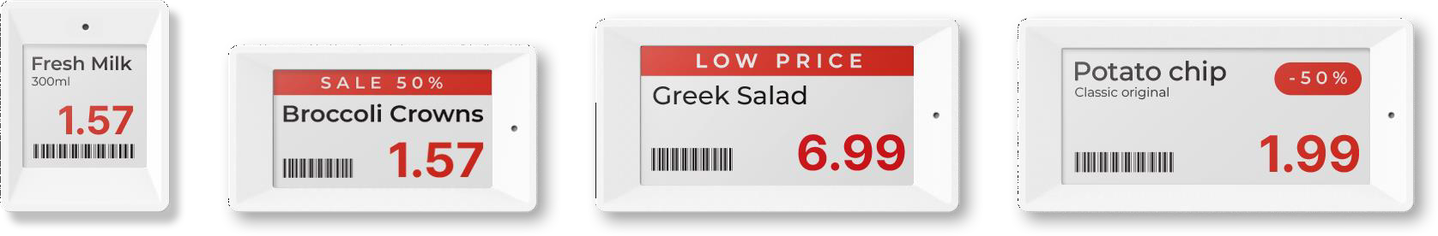



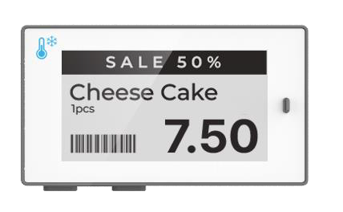
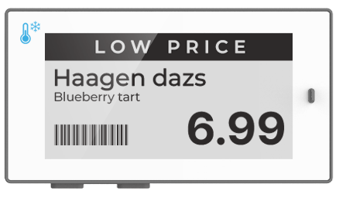
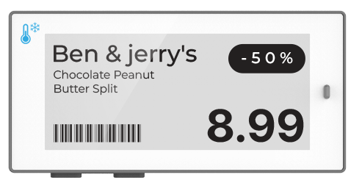
SOLUM RETAIL ESL
PRODUCT LINE-UP
NEWTON CORE LINE-UP (1/4)
4
N E W T O N C O R E l W H I T E F R A M E
1.6”
2.2”
2.6”
2.9”
N E W T O N F R E E Z E R l W H I T E F R A M E
FREEZER 2.2”
FREEZER 2.6”
FREEZER 2.9”

Slide 5
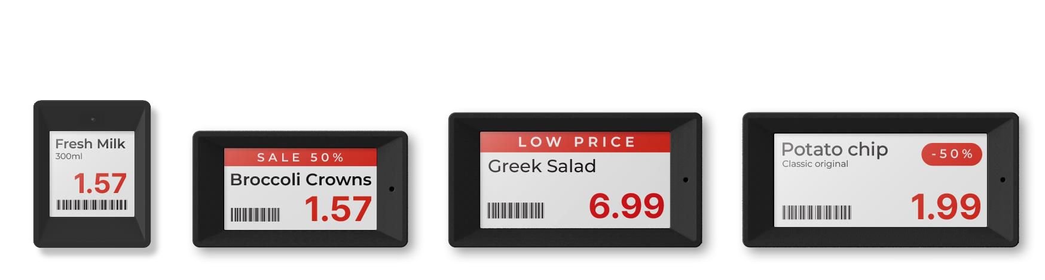
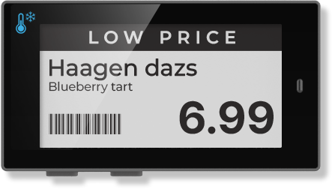
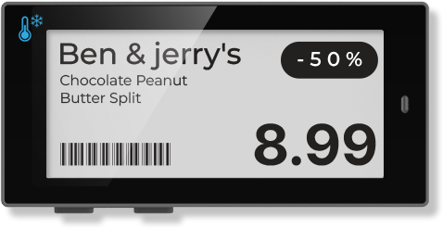
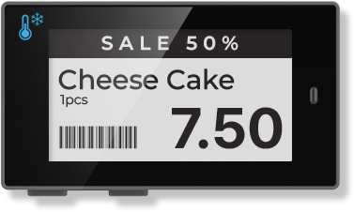
SOLUM RETAIL ESL
PRODUCT LINE-UP
NEWTON CORE LINE-UP (2/4)
5
N E W T O N C O R E l B L A C K F R A M E
1.6”
2.2”
2.6”
2.9”
N E W T O N F R E E Z E R l B L A C K F R A M E
FREEZER 2.2”
FREEZER 2.6”
FREEZER 2.9”

Slide 6
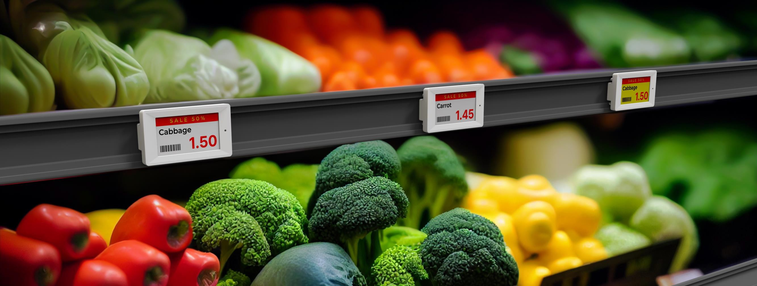
SOLUM RETAIL ESL
PRODUCT LINE-UP
NEWTON CORE LINE-UP (3/4)
6
N E W T O N C O R E l A P P L I C A T I O N 2 . 2 ”

Slide 7
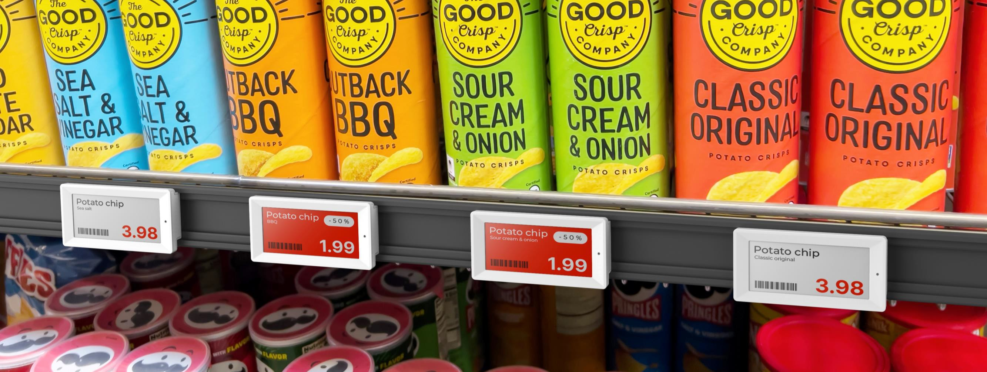
SOLUM RETAIL ESL
PRODUCT LINE-UP
NEWTON CORE LINE-UP (4/4)
7
N E W T O N C O R E l A P P L I C A T I O N 2 . 9 ”

Slide 8
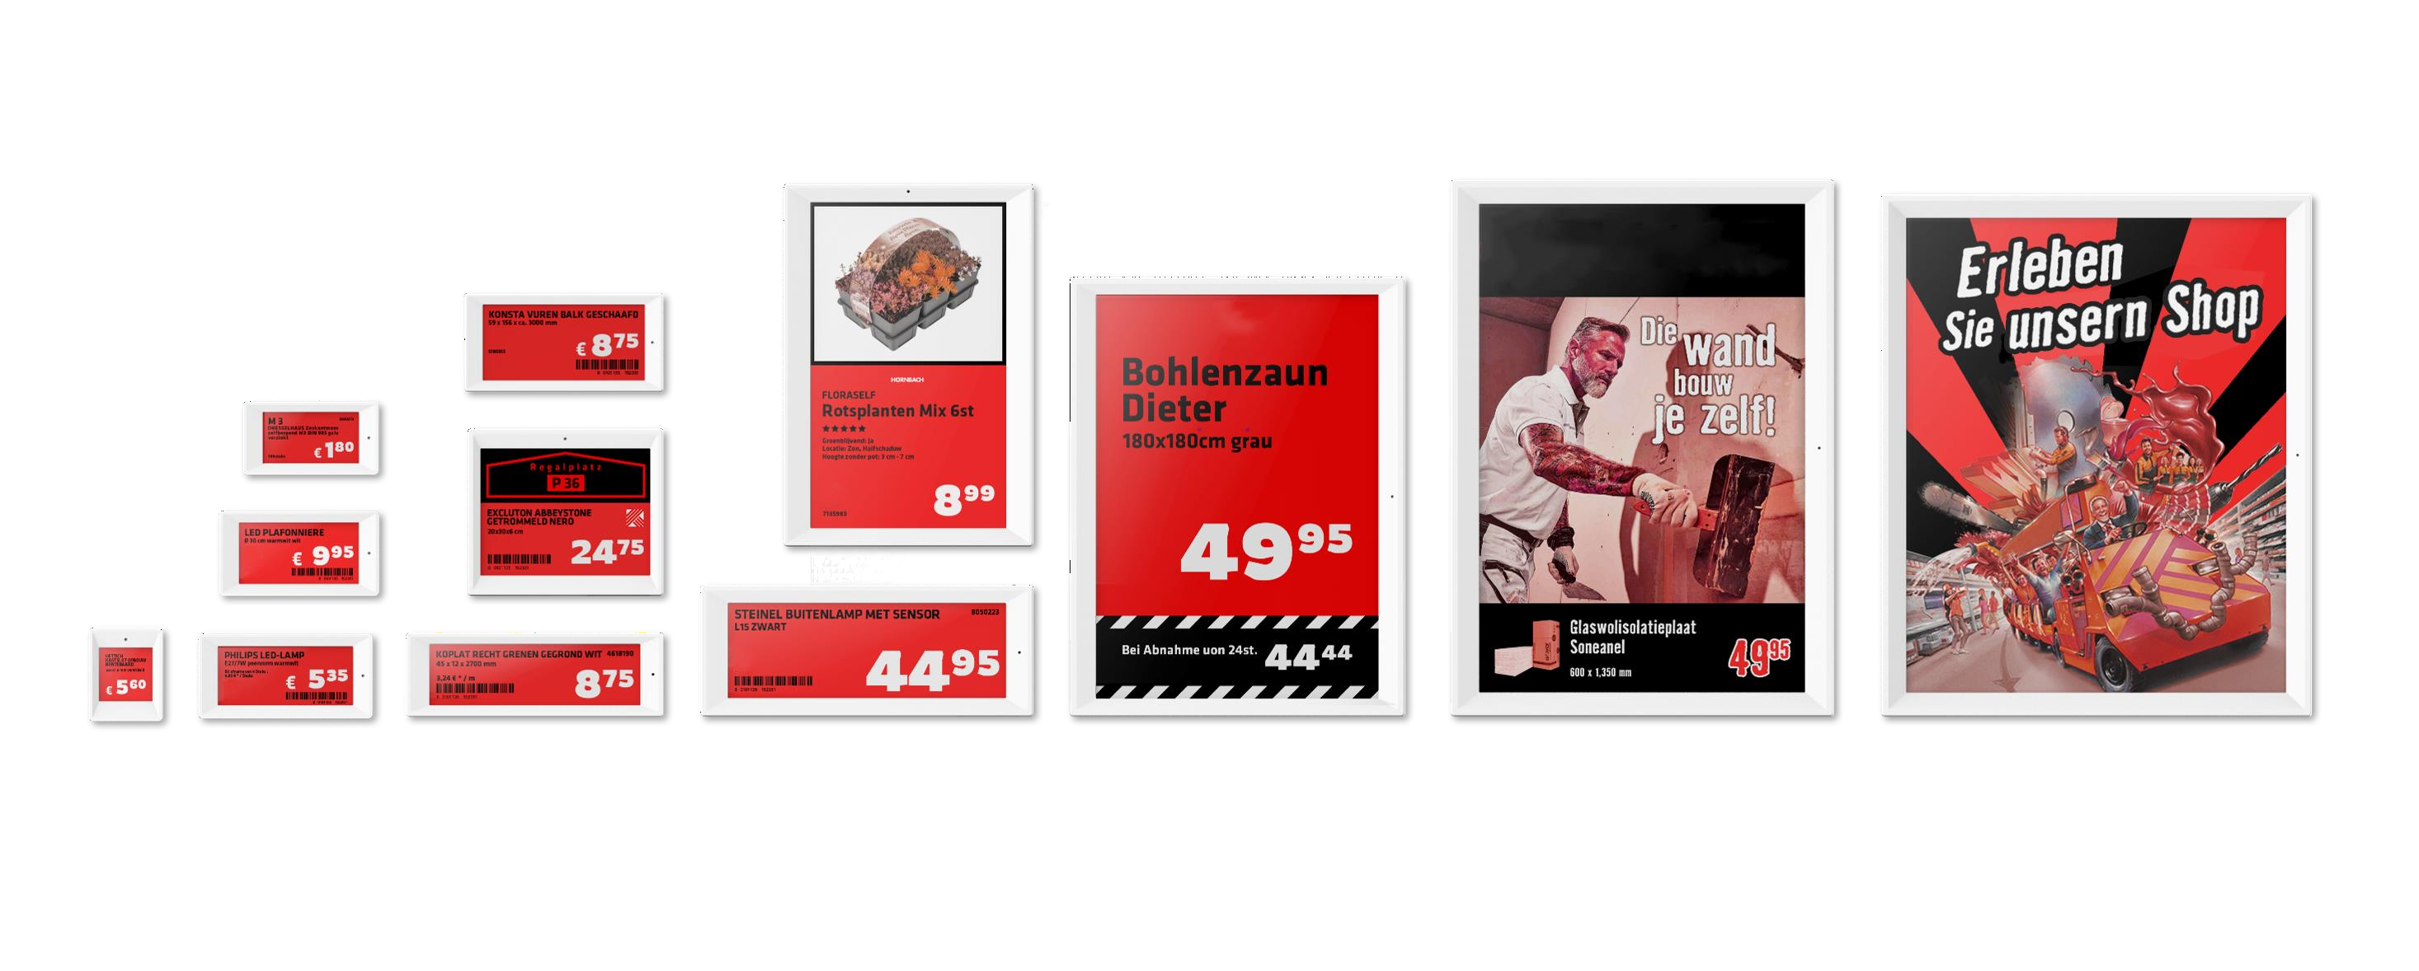

NEWTON Line-up
N E W T O N C O R E B W R ( 1.6”, 2.2”, 2.6”,2.9”, 3.52”, 4.2”, 4.3”, 5.85”, 7.5”, 9.7”, 11.6”, 12.2”)
3.52”
2.2”
7.5”
2.6”
4.2”
1.6”
2.9”
4.3”
5.85”
9.7”
11.6”
12.2”

Slide 9
N E W T O N C O R E B W R S P E C I F I C AT I O N l 1.6”, 2.2”, 2.6”, 2.9”, 3.52”, 4.2”, 4.3”, 5.85”, 7.5”, 9.7”, 11.6”, 12.2”
NEWTON SIZES | 1.6” | 2.2” | 2.6” | 2.9” | 3.52” | 4.2” | 4.3” | 5.85” | 7.5” | 9.7” | 11.6” | 12.2”
DIMENSION | 37.08 x 46.75 x 11.52 mm | 68.05 x 36.95 x 11.52mm | 80.14 x 42.79 x 11.52 mm | 87.33 x 42.79 x 11.52mm | 99.58 x 49.19 x 12.15 mm | 97.92 x 83.65 x 13.30 mm | 128.62 x 41.94 x 12.15 mm | 166.27 x 65.78 x 13.30 mm | 181.27 x 124.84 x 13.80 mm | 167.65 x 220.04 x 13.80 mm | 272.37 x 210.00 x 14.20 mm | 261.56 x 215.24 x 14.20 mm
ACTIVE DISPLAY AREA | 27.0 x 27.0 mm 1.0 x 1.0 inch | 48.1 x 26.0 mm 1.8 x 1.0 inch | 60.1 x 30.7 mm 2.3 x 1.2 inch | 67.6 x 29.6 mm 2.6 x 1.1 inch | 81.0 x 37.9 mm 3.1 x 1.5 inch | 84.8 x 63.6 mm 3.3 x 2.5 inch | 105.4 x 30.7 mm 4.14 x 1.20 inch | 47.7 x 139.0 mm 1.87 x 5.47 inch | 163.2 x 97.9 mm 6.4 x 3.8 inch | 141.1 x 201.6 mm 5.55 x 7.93 inch | 163.0 x 244.5 mm 6.4 x 9.62 inch | 190.1 x 237.6 mm 7.48 x 9.35 inch
RESOLUTION(Pixel) | 200 x 200 | 296 x 160 | 360 x 184 | 384 x 168 | 384 x 180 | 400 x 300 | 522 x 152 | 792 x 272 | 800 x 480 | 672 x 960 | 640 x 960 | 768 x 960
PIXEL DENSITY | 184 dpi | 156 dpi | 152 dpi | 144 dpi | 120 dpi | 120 dpi | 125 dpi | 145 dpi | 126 dpi | 121 dpi | 100 dpi | 103 dpi
DISPLAY TECHNOLOGY | Full Graphic E-Ink Display
PIXEL COLORS | BWR(Black, White, Red)
VIEWING ANGLE | Nearly 180°
USABLE PAGES | Up to 7 pages | Up to 7 pages | Up to 7 pages | Up to 7 pages | Up to 7 pages | Up to 7 pages | Up to 7 pages | Up to 7 pages | Up to 7 pages | Up to 7 pages | Up to 3 pages | Up to 7 pages
OPERATING TEMPERATURE | 32 ~ 104F (0 ~ 40°) @45~70% RH
BATTERY | CR2450 x 1 | CR2450 x 2 | CR2450 x 2 | CR2450 x 2 | CR2450 x 2 | CR2450 x 2 | CR2450 x 2 | CR2450 x 3 | CR2450 x 4 | CR2450 x 5 | AA x 4 | CR2450 x 6
BATTERY LIFETIME | Over 10 years
ENCRYPTION | 128-Bit AES Encryption
COMPLIANCE | CE, ROHS, FCC
NFC | Built-in Felica NFC Forum Type 3
LED | 7 Colors(Red/Green/Blue/Yellow/Cyan/Magenta/White)
ESL OPERATING FREQUENCY | 2.4 Ghz
WIRELESS FIRMWARE UPDATE | Yes
Ⓒ 2023 SOLUM PROPRIETARY AND CONFIDENTIAL

Slide 10
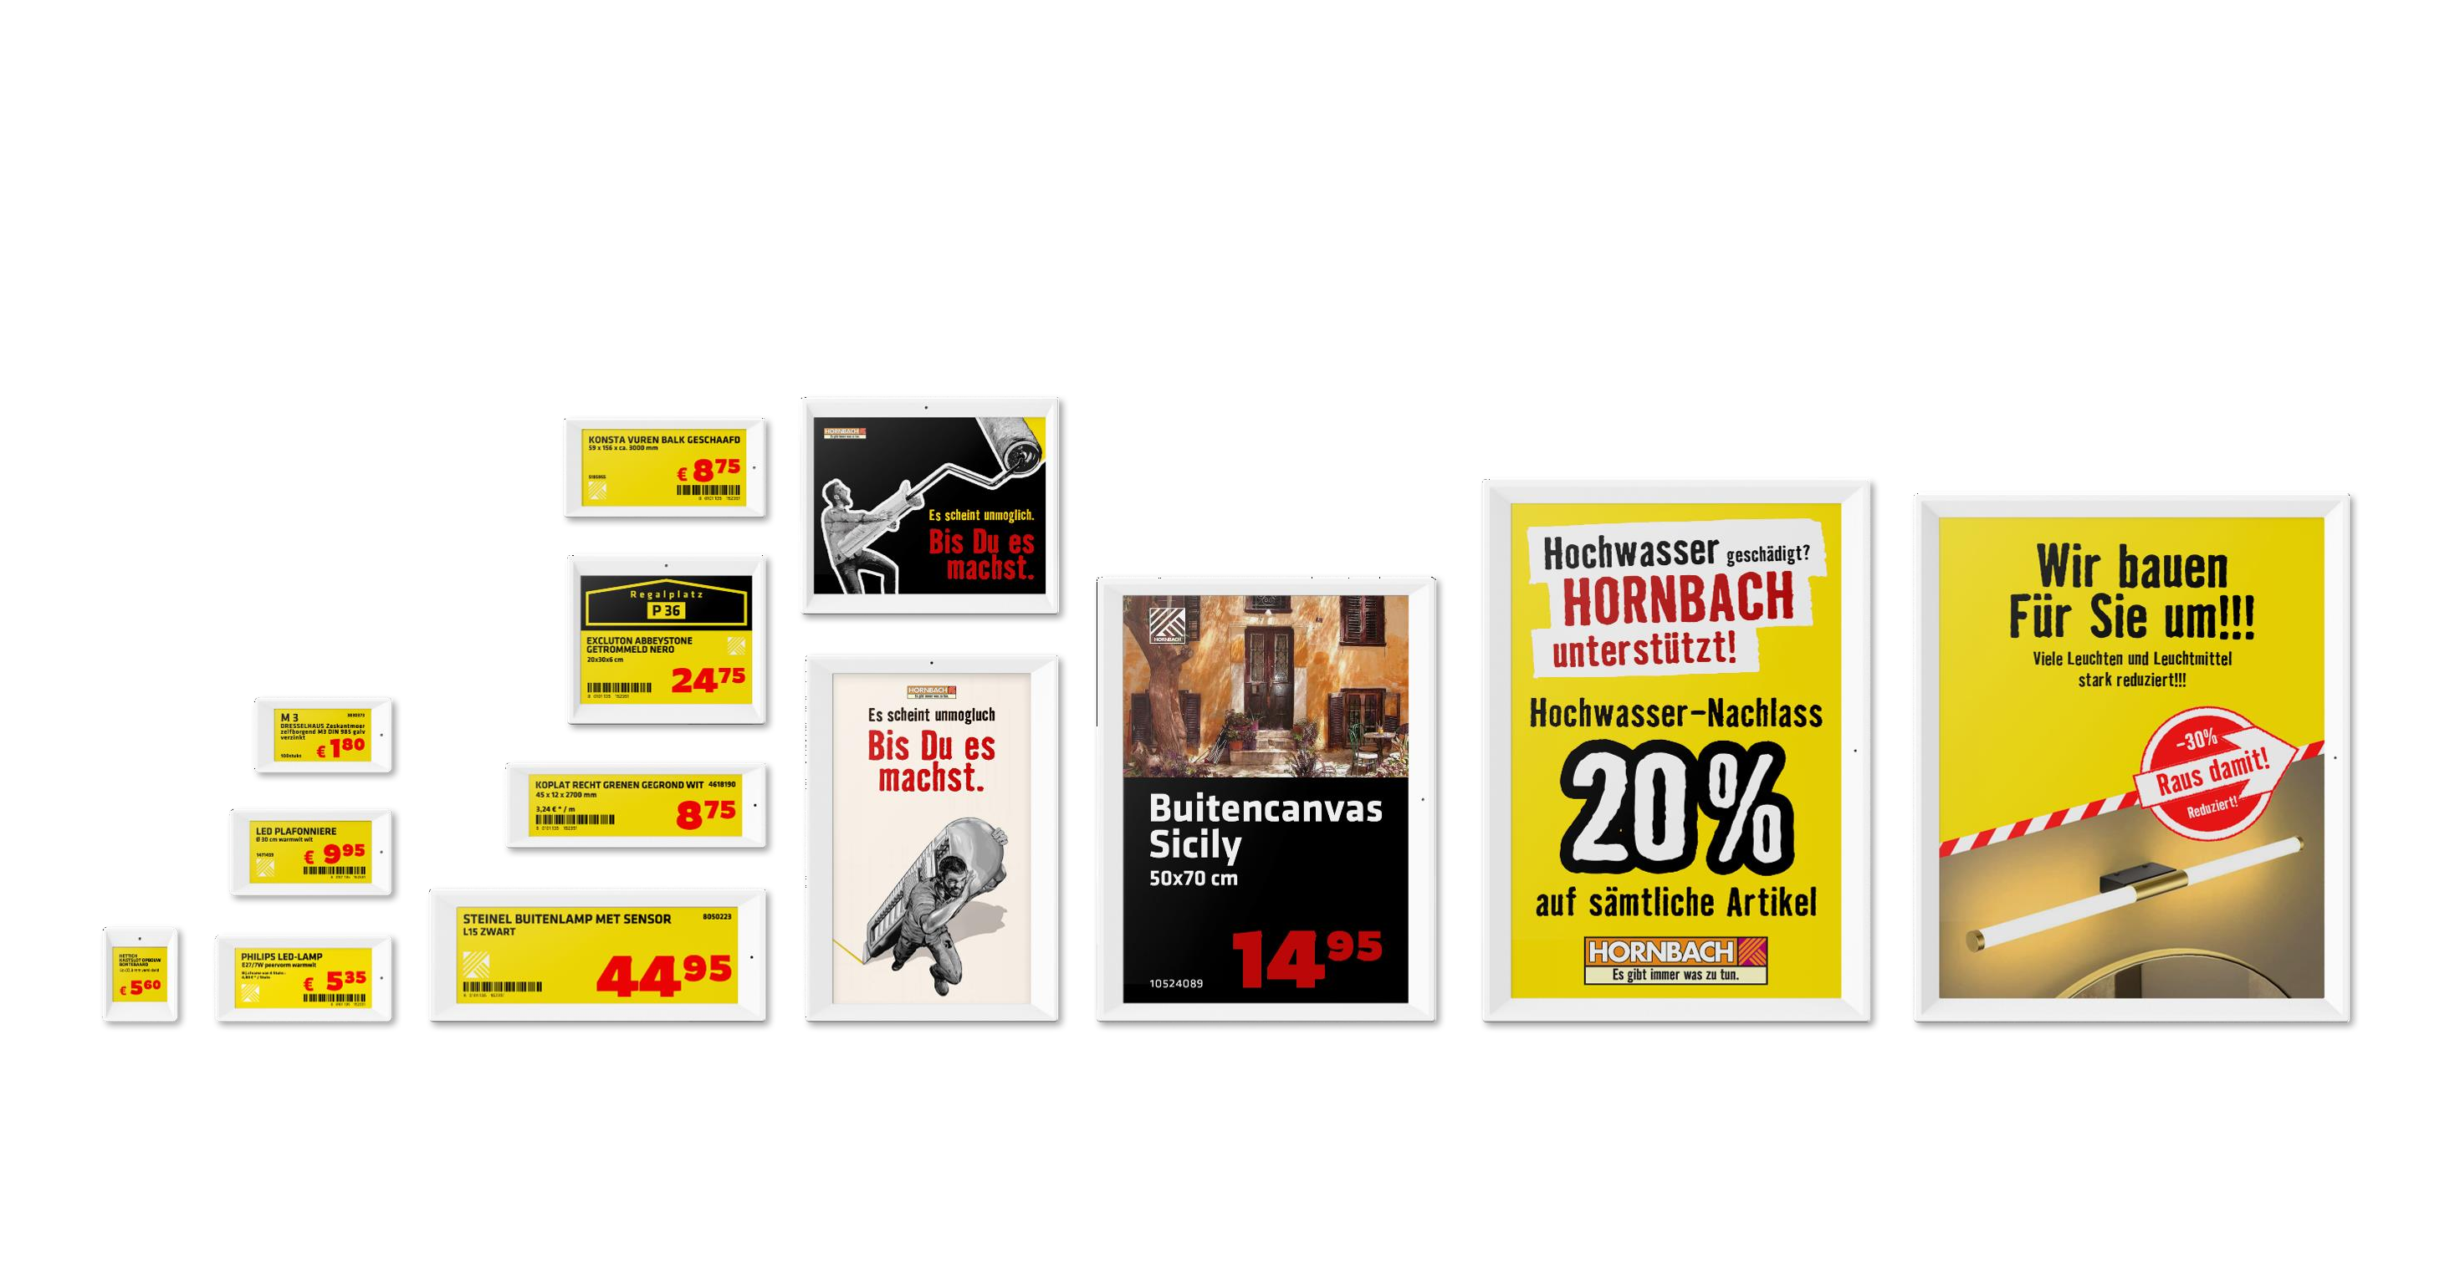
NEWTON Line-up
N E W T O N C O R E ( S E M I - C O R E ) B W R Y ( 1.6”, 2.2”, 2.6”,2.9”, 3.52”, 4.2”, 4.3”, 5.85”, 6.0”, 7.5”, 9.7”, 11.6”, 12.2”)
3.52”
6.0”
4.2”
2.2”
4.3”
2.6”
1.6”
2.9”
5.85”
7.5”
9.7”
11.6”
12.2”

Slide 11
N E W T O N C O R E B W R Y S P E C I F I C AT I O N l 1.6”, 2.2”, 2.6”, 2.9”, 3.52”, 4.2”, 4.3”, 5.85”, 6.0”, 7.5”, 9.7”, 11.6”, 12.2”
NEWTON SIZES | 1.6” | 2.2” | 2.6” | 2.9” | 3.52” | 4.2” | 4.3” | 5.85” | 6.0” | 7.5” | 9.7” | 11.6” | 12.2”
DIMENSION | 37.08 x 46.75 x 11.52 mm | 68.05 x 36.95 x 11.52mm | 80.14 x 42.79 x 11.52 mm | 87.33 x 42.79 x 12.15mm | 99.58 x 49.19 x 12.15 mm | 97.92 x 83.65 x 13.30 mm | 128.62 x 41.94 x 12.15 mm | 166.27 x 65.78 x 13.30 mm | 138.53 x 124.07 x 13.80 mm | 181.27 x 124.84 x 13.80 mm | 167.65 x 220.04 x 13.80 mm | 272.37 x 210.00 x 14.20 mm | 261.56 x 215.24 x 14.20 mm
ACTIVE DISPLAY AREA | 27.0 x 27.0 mm 1.0 x 1.0 inch | 48.1 x 26.0 mm 1.8 x 1.0 inch | 60.1 x 30.7 mm 2.3 x 1.2 inch | 57.3 x 38.1 mm 2.25 x 1.50 inch | 67.6 x 29.6 mm 2.6 x 1.1 inch | 84.8 x 63.6 mm 3.3 x 2.5 inch | 105.4 x 30.7 mm 4.14 x 1.20 inch | 47.7 x 139.0 mm 1.87 x 5.47 inch | 114.9 x 85.8 mm 4.5 x 1.20 inch | 163.2 x 97.9 mm 6.4 x 3.8 inch | 141.1 x 201.6 mm 5.55 x 7.93 inch | 163.0 x 244.5 mm 6.4 x 9.62 inch | 190.1 x 237.6 mm 7.48 x 9.35 inch
RESOLUTION(Pixel) | 200 x 200 | 296 x 160 | 360 x 184 | 384 x 168 | 384 x 180 | 400 x 300 | 522 x 152 | 792 x 272 | 600 x 448 | 800 x 480 | 672 x 960 | 640 x 960 | 768 x 960
PIXEL DENSITY | 184 dpi | 156 dpi | 152 dpi | 144 dpi | 120 dpi | 120 dpi | 125 dpi | 145 dpi | 132 dpi | 126 dpi | 121 dpi | 100 dpi | 103 dpi
DISPLAY TECHNOLOGY | Full Graphic E-Ink Display
PIXEL COLORS | BW(Black, White) / BWR(Black, White, Red) / BWRY(Black, White, Red, Yellow)
VIEWING ANGLE | Nearly 180°
USABLE PAGES | Up to 7 pages | Up to 7 pages | Up to 7 pages | Up to 7 pages | Up to 7 pages | Up to 7 pages | Up to 7 pages | Up to 7 pages | Up to 7 pages | Up to 7 pages | Up to 7 pages | Up to 3 pages | Up to 7 pages
OPERATING TEMPERATURE | 50 ~ 104F (10 ~ 40°) @45~70% RH
BATTERY | CR2450 x 1 | CR2450 x 2 | CR2450 x 2 | CR2450 x 2 | CR2450 x 2 | CR2450 x 2 | CR2450 x 2 | CR2450 x 3 | CR2450 x 4 | CR2450 x 4 | CR2450 x 5 | AA x 4 | CR2450 x 6
BATTERY LIFETIME | Over 10 years
ENCRYPTION | 128-Bit AES Encryption
COMPLIANCE | CE, ROHS, FCC
NFC | Built-in Felica NFC Forum Type 3
LED | 7 Colors(Red/Green/Blue/Yellow/Cyan/Magenta/White)
ESL OPERATING FREQUENCY | 2.4 Ghz
WIRELESS FIRMWARE UPDATE | Yes
Ⓒ 2023 SOLUM PROPRIETARY AND CONFIDENTIAL

Slide 12
Ⅱ . N E W T O N C O R E K E Y F E A T U R E

Slide 13

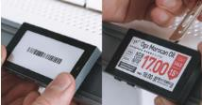


SOLUM RETAIL ESL
ABOUT ESL
ESL FEATURES
9
K E Y F E A T U R E S l H / W
10 Years Battery Life
Easy Locking System
2 updates a day, Operating temperature 10 – 40 degrees (general OP 0 – 40 degrees)100 sec blinking per day. Sustainable battery concept with changeable batteries (CR2450)
Installation and removal have never been easier with Newton’s easy lockin g system. You won`t need any other tools to install it. Just use the Newton r emover to detach a tag from the shelves
7 Colors LED
This new generation tag allows continuous LED blinking for promotional purposes. With 3 sec of interval and 8 hours of operation in a day (8,228 times of LED light per day) and for 100 days for a year, the battery life can still go up to 5 years. LED colors : (RYGTBVW)
Customizable Design
The real beauty of Newton is the fact that it is customizable. With Newton, you can
incorporate your company’s colors, patterns, and company logo

Slide 14




SOLUM RETAIL ESL
ABOUT ESL
ESL FEATURES
10
K E Y F E A T U R E S l H / W
x10 Fast Update Speed
High Resolution
Three thousand tags can be updated within 5 minutes with a single Newton Gateway, which means it takes 0.1 seconds to update one tag. That makes Newton 10 times faster compared to other ESLs.
Newton’s screen resolution got upgraded by 20%, and now the crisp and the clear display
comes with 184 dpi for 1,6” and 144dpi for our 2,9”
Up to 7 Page
Collision-free Communication
From nutritional facts to expiration dates to allergy warnings, all of this information can be
uploaded into Newton’s 7 pages. Using the multifunctional buttons, customers can flip through
the different pages to access more data about the product.)
Newton allows more than 60 RF channels (meanwhile, competitors offer only 11~16 available channels) which means it’s a lot easier to select the communication channels in case of a very crowded WIFI circumstance.
NFC
Newton’s built-in NFC capabilities allow you to perform mobile payments (self-checkout), link
to your company’s online website, and download a digital coupon.

Slide 15
Ⅲ . N E W T O N C O R E S P E C I F I C A T I O N S

Slide 16
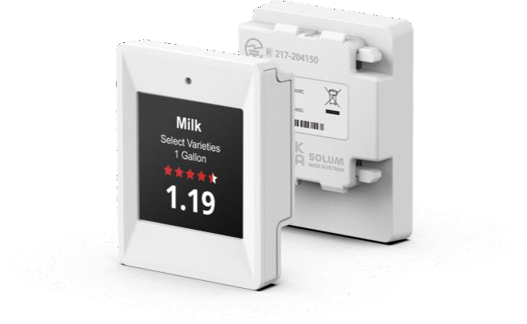
SOLUM RETAIL ESL
PRODUCT LINE-UP
SPECIFICATIONS(1/14)
12
N E W T O N C O R E l 1 . 6 I N C H
P R O D U C T S P E C I F I C A T I O N
MODEL | TBD
DIMENSION | 37.08 × 46.75 × 11.52 mm
ACTIVE DISPLAY AREA | 27.0 × 27.0 mm / 1.00 × 1.00 inch
RESOLUTION (Pixel) | 200 × 200
PIXEL DENSITY | 184 dpi
DISPLAY TECHNOLOGY | Full Graphic E-ink Display
BEZEL COLOR | White or Black, Customizable Color(Optional)
PIXEL COLORS | BWR(Black, White, Red)
VIEWING ANGLE | Nearly 180˚
USABLE PAGES | Up to 7 pages
OPERATING TEMPERATURE | 0 ~ 40℃ (32 ~ 104℉)
BATTERY | CR2450 × 1ea
BATTERY LIFTIME | Up To 5 years (2 updates/day) ※ 3 years in 0~10 ℃
ENCRYPTION | 128-Bit AES
COMPLIANCE | CE, RoHS, FCC
NFC | FeliCa NFC Forum Type 3
WATERPROOF | N/A
BUTTON | X
LED | 7 Colors (Red/Green/Blue/Yellow/Cyan/Magenta/White)
ESL OPERATING FREQUENCY | 2.4 GHz
WIRELESS FIRMWARE UPDATE | Yes
※ This specification may vary depending on the installation environment and user scenario. This document is subject to change without notice.

Slide 17
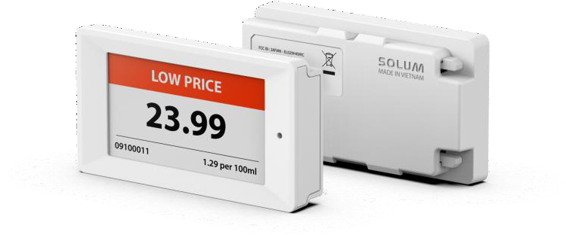
SOLUM RETAIL ESL
PRODUCT LINE-UP
SPECIFICATIONS(2/14)
13
N E W T O N C O R E l 2 . 2 I N C H
P R O D U C T S P E C I F I C A T I O N
MODEL | TBD
DIMENSION | 68.05 × 36.95 × 11.52 mm
ACTIVE DISPLAY AREA | 48.1 × 26.0 mm / 1.80 × 1.02 inch
RESOLUTION (Pixel) | 296 × 160
PIXEL DENSITY | 156 dpi
DISPLAY TECHNOLOGY | Full Graphic E-ink Display
BEZEL COLOR | White or Black, Customizable Color(Optional)
PIXEL COLORS | BWR(Black, White, Red)
VIEWING ANGLE | Nearly 180˚
USABLE PAGES | Up to 7 pages
OPERATING TEMPERATURE | 0 ~ 40℃ (32 ~ 104℉)
BATTERY | CR2450 × 2ea
BATTERY LIFTIME | Up To 10 years (2 updates/day) ※ 5 years in 0~10 ℃
ENCRYPTION | 128-Bit AES
COMPLIANCE | CE, RoHS, FCC
NFC | FeliCa NFC Forum Type 3
WATERPROOF | N/A
BUTTON | X
LED | 7 Colors (Red/Green/Blue/Yellow/Cyan/Magenta/White)
ESL OPERATING FREQUENCY | 2.4 GHz
WIRELESS FIRMWARE UPDATE | Yes
※ This specification may vary depending on the installation environment and user scenario. This document is subject to change without notice.

Slide 18
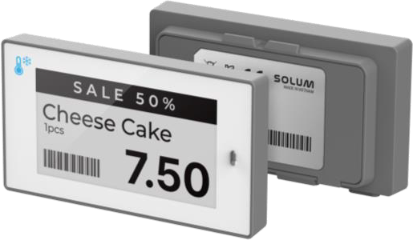
SOLUM RETAIL ESL
PRODUCT LINE-UP
SPECIFICATIONS(3/14)
14
N E W T O N F R E E Z E R l 2 . 2 I N C H
P R O D U C T S P E C I F I C A T I O N
MODEL | W:ELF22H3WMA/WWW
DIMENSION | 67.1 × 37.4 × 13.1 mm / 2.64 × 1.47 × 0.51 inch
ACTIVE DISPLAY AREA | 48.1 × 26.0 mm / 1.89 × 1.02 inch
RESOLUTION (Pixel) | 296 × 160
PIXEL DENSITY | 156 dpi
DISPLAY TECHNOLOGY | Full Graphic E-ink Display
BEZEL COLOR | White or Black, Customizable Color(Optional)
PIXEL COLORS | BW
VIEWING ANGLE | Nearly 180˚
USABLE PAGES | Up to 7 pages
OPERATING TEMPERATURE | -25 ~ 0℃ (-13 ~ 32℉)
BATTERY | CR2450 × 2ea
BATTERY LIFTIME | Up To 3 years (1 Update/day)
ENCRYPTION | 128-Bit AES
COMPLIANCE | CE, RoHS, FCC
NFC | FeliCa NFC Forum Type 3
WATERPROOF | IP67
BUTTON | 2 Buttons
LED | 7 Colors (Red/Green/Blue/Yellow/Cyan/Magenta/White)
ESL OPERATING FREQUENCY | 2.4 GHz
WIRELESS FIRMWARE UPDATE | Yes
※ This specification may vary depending on the installation environment and user scenario. This document is subject to change without notice.

Slide 19
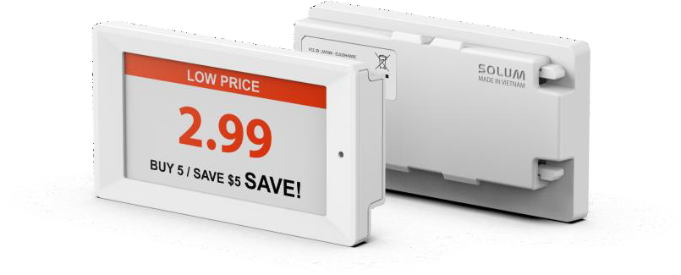
SOLUM RETAIL ESL
PRODUCT LINE-UP
SPECIFICATIONS(4/14)
15
N E W T O N C O R E l 2 . 6 I N C H
P R O D U C T S P E C I F I C A T I O N
MODEL | TBD
DIMENSION | 80.14 × 42.79 × 11.52 mm
ACTIVE DISPLAY AREA | 60.1 × 30.7 mm / 2.30 × 1.20 inch
RESOLUTION (Pixel) | 360 × 184
PIXEL DENSITY | 152 dpi
DISPLAY TECHNOLOGY | Full Graphic E-ink Display
BEZEL COLOR | White or Black, Customizable Color(Optional)
PIXEL COLORS | BWR(Black, White, Red)
VIEWING ANGLE | Nearly 180˚
USABLE PAGES | Up to 7 pages
OPERATING TEMPERATURE | 0 ~ 40℃ (32 ~ 104℉)
BATTERY | CR2450 × 2ea
BATTERY LIFTIME | Up To 10 years (2 updates/day) ※ 5 years in 0~10 ℃
ENCRYPTION | 128-Bit AES
COMPLIANCE | CE, RoHS, FCC
NFC | FeliCa NFC Forum Type 3
WATERPROOF | N/A
BUTTON | X
LED | 7 Colors (Red/Green/Blue/Yellow/Cyan/Magenta/White)
ESL OPERATING FREQUENCY | 2.4 GHz
WIRELESS FIRMWARE UPDATE | Yes
※ This specification may vary depending on the installation environment and user scenario. This document is subject to change without notice.

Slide 20
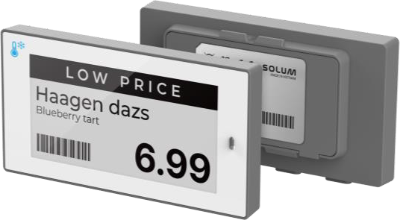
SOLUM RETAIL ESL
PRODUCT LINE-UP
SPECIFICATIONS(5/14)
16
N E W T O N F R E E Z E R l 2 . 6 I N C H
P R O D U C T S P E C I F I C A T I O N
MODEL | W:ELF26H3WMA/WWW
DIMENSION | 79.3 × 42.4 × 13.1 mm / 3.12 × 1.66 × 0.51 inch
ACTIVE DISPLAY AREA | 60.1 × 30.7 mm / 2.36 × 1.20 inch
RESOLUTION (Pixel) | 360 × 184
PIXEL DENSITY | 152 dpi
DISPLAY TECHNOLOGY | Full Graphic E-ink Display
BEZEL COLOR | White or Black, Customizable Color(Optional)
PIXEL COLORS | BW(Black, White)
VIEWING ANGLE | Nearly 180˚
USABLE PAGES | Up to 7 pages
OPERATING TEMPERATURE | -25 ~ 0℃ (-13 ~ 32℉)
BATTERY | CR2450 × 2ea
BATTERY LIFTIME | Up To 3 years (1 Update/day)
ENCRYPTION | 128-Bit AES
COMPLIANCE | CE, RoHS, FCC
NFC | FeliCa NFC Forum Type 3
WATERPROOF | IP67
BUTTON | 2 Buttons
LED | 7 Colors (Red/Green/Blue/Yellow/Cyan/Magenta/White)
ESL OPERATING FREQUENCY | 2.4 GHz
WIRELESS FIRMWARE UPDATE | Yes
※ This specification may vary depending on the installation environment and user scenario. This document is subject to change without notice.

Slide 21
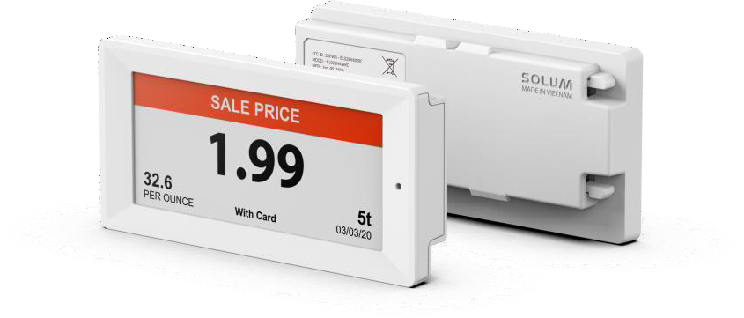
SOLUM RETAIL ESL
PRODUCT LINE-UP
SPECIFICATIONS(6/14)
17
N E W T O N C O R E l 2 . 9 I N C H
P R O D U C T S P E C I F I C A T I O N
MODEL | TBD
DIMENSION | 87.33 × 42.79 × 11.52 mm
ACTIVE DISPLAY AREA | 67.6 × 29.6 mm / 2.60 × 1.10 inch
RESOLUTION (Pixel) | 384 × 168
PIXEL DENSITY | 144 dpi
DISPLAY TECHNOLOGY | Full Graphic E-ink Display
BEZEL COLOR | White or Black, Customizable Color(Optional)
PIXEL COLORS | BWR(Black, White, Red)
VIEWING ANGLE | Nearly 180˚
USABLE PAGES | Up to 7 pages
OPERATING TEMPERATURE | 0 ~ 40℃ (32 ~ 104℉)
BATTERY | CR2450 × 2ea
BATTERY LIFTIME | Up To 10 years (2 updates/day) ※ 5 years in 0~10 ℃
ENCRYPTION | 128-Bit AES
COMPLIANCE | CE, RoHS, FCC
NFC | FeliCa NFC Forum Type 3
WATERPROOF | N/A
BUTTON | X
LED | 7 Colors (Red/Green/Blue/Yellow/Cyan/Magenta/White)
ESL OPERATING FREQUENCY | 2.4 GHz
WIRELESS FIRMWARE UPDATE | Yes
※ This specification may vary depending on the installation environment and user scenario. This document is subject to change without notice.

Slide 22
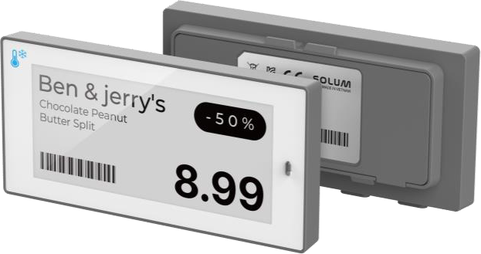
SOLUM RETAIL ESL
PRODUCT LINE-UP
SPECIFICATIONS(7/14)
18
N E W T O N F R E E Z E R l 2 . 9 I N C H
P R O D U C T S P E C I F I C A T I O N
MODEL | W:ELF29H3WMA/WWW
DIMENSION | 86.0 × 41.3 × 13.1 mm / 3.38 × 1.62 × 0.51 inch
ACTIVE DISPLAY AREA | 67.6 × 29.6 mm / 2.66 × 1.16 inch
RESOLUTION (Pixel) | 384 × 168
PIXEL DENSITY | 144 dpi
DISPLAY TECHNOLOGY | Full Graphic E-ink Display
BEZEL COLOR | White or Black, Customizable Color(Optional)
PIXEL COLORS | BW(Black, White)
VIEWING ANGLE | Nearly 180˚
USABLE PAGES | Up to 7 pages
OPERATING TEMPERATURE | -25 ~ 0℃ (-13 ~ 32℉)
BATTERY | CR2450 × 2ea
BATTERY LIFTIME | Up To 3 years (1 Update/day)
ENCRYPTION | 128-Bit AES
COMPLIANCE | CE, RoHS, FCC
NFC | FeliCa NFC Forum Type 3
WATERPROOF | IP67
BUTTON | 2 Buttons
LED | 7 Colors (Red/Green/Blue/Yellow/Cyan/Magenta/White)
ESL OPERATING FREQUENCY | 2.4 GHz
WIRELESS FIRMWARE UPDATE | Yes
※ This specification may vary depending on the installation environment and user scenario. This document is subject to change without notice.

Slide 23
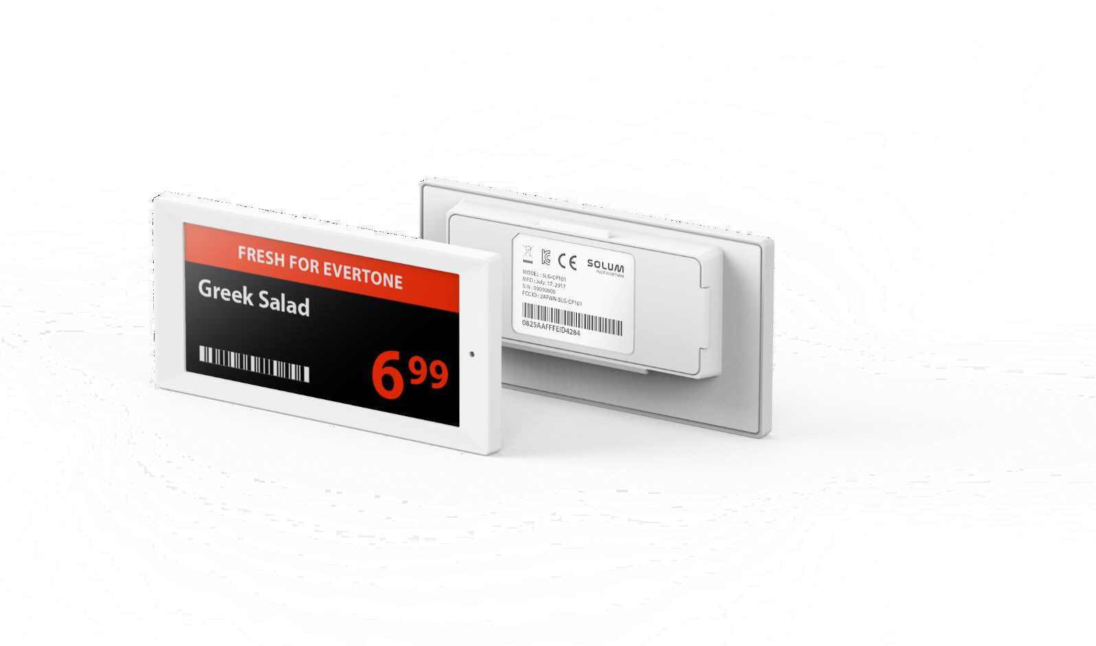
SOLUM RETAIL ESL
PRODUCT LINE-UP
SPECIFICATIONS(8/14)
19
N E W T O N C O R E l 3 . 5 2 I N C H
P R O D U C T S P E C I F I C A T I O N
MODEL | TBD
DIMENSION | 99.58 × 49.19 × 11.52 mm
ACTIVE DISPLAY AREA | 81.0 x 37.9 mm / 3.1 x 1.1 inch
RESOLUTION (Pixel) | 384 x 180
PIXEL DENSITY | 120 dpi
DISPLAY TECHNOLOGY | Full Graphic E-ink Display
BEZEL COLOR | White or Black, Customizable Color(Optional)
PIXEL COLORS | BWR(Black, White, Red)
VIEWING ANGLE | Nearly 180˚
USABLE PAGES | Up to 7 pages
OPERATING TEMPERATURE | 0 ~ 40℃ (32 ~ 104℉)
BATTERY | Battery Pack(CR2450 × 2ea)
BATTERY LIFTIME | Up To 10 years (2 updates/day) ※ 5 years in 0~10 ℃
ENCRYPTION | 128-Bit AES
COMPLIANCE | CE, RoHS, FCC
NFC | FeliCa NFC Forum Type 3
WATERPROOF | N/A
BUTTON | X
LED | 7 Colors (Red/Green/Blue/Yellow/Cyan/Magenta/White)
ESL OPERATING FREQUENCY | 2.4 GHz
WIRELESS FIRMWARE UPDATE | Yes
※ This specification may vary depending on the installation environment and user scenario. This document is subject to change without notice.

Slide 24
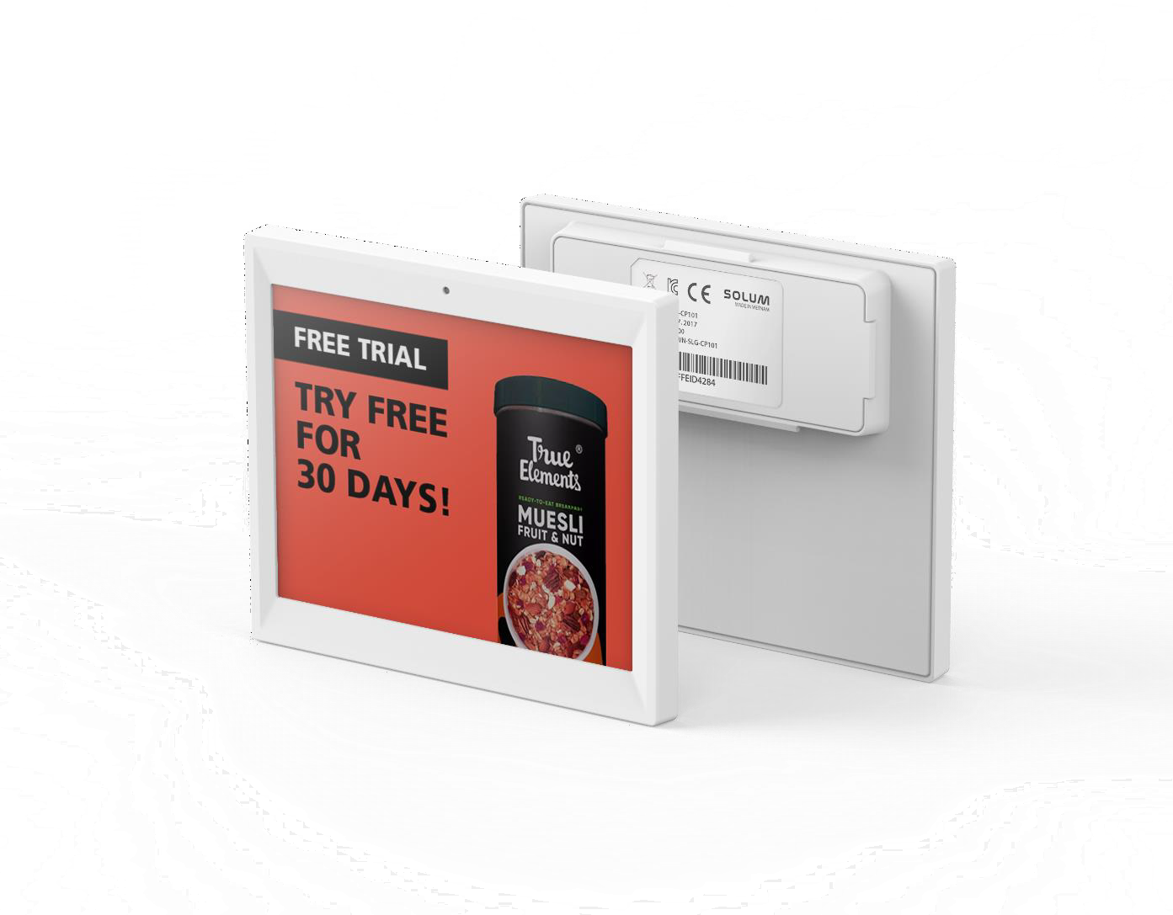
SOLUM RETAIL ESL
PRODUCT LINE-UP
SPECIFICATIONS(9/14)
20
N E W T O N C O R E l 4 . 2 I N C H
P R O D U C T S P E C I F I C A T I O N
MODEL | TBD
DIMENSION | 97.92 × 83.65 × 13.30 mm
ACTIVE DISPLAY AREA | 84.8 x 63.6 mm / 3.3 x 2.5 inch
RESOLUTION (Pixel) | 400 x 300
PIXEL DENSITY | 120 dpi
DISPLAY TECHNOLOGY | Full Graphic E-ink Display
BEZEL COLOR | White or Black, Customizable Color(Optional)
PIXEL COLORS | BWR(Black, White, Red)
VIEWING ANGLE | Nearly 180˚
USABLE PAGES | Up to 7 pages
OPERATING TEMPERATURE | 0 ~ 40℃ (32 ~ 104℉)
BATTERY | Battery Pack(CR2450 × 2ea)
BATTERY LIFTIME | Up To 10 years (2 updates/day) ※ 5 years in 0~10 ℃
ENCRYPTION | 128-Bit AES
COMPLIANCE | CE, RoHS, FCC
NFC | FeliCa NFC Forum Type 3
WATERPROOF | N/A
BUTTON | X
LED | 7 Colors (Red/Green/Blue/Yellow/Cyan/Magenta/White)
ESL OPERATING FREQUENCY | 2.4 GHz
WIRELESS FIRMWARE UPDATE | Yes
※ This specification may vary depending on the installation environment and user scenario. This document is subject to change without notice.

Slide 25
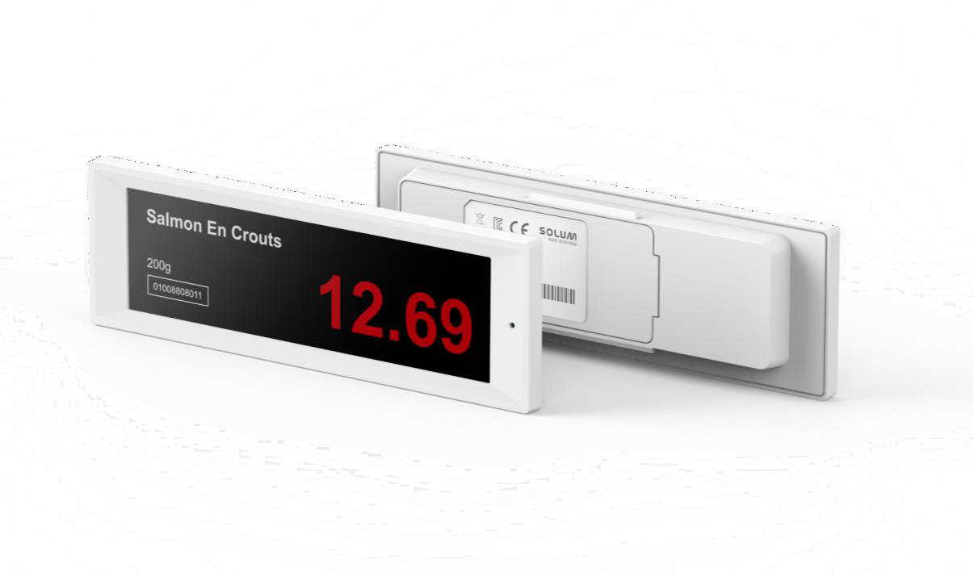
SOLUM RETAIL ESL
PRODUCT LINE-UP
SPECIFICATIONS(10/14)
21
N E W T O N C O R E l 4 . 3 I N C H
P R O D U C T S P E C I F I C A T I O N
MODEL | TBD
DIMENSION | 128.62 × 41.94 × 12.15 mm
ACTIVE DISPLAY AREA | 105.4 × 30.7 mm / 4.14 × 1.20 inch
RESOLUTION (Pixel) | 522 × 152
PIXEL DENSITY | 125 dpi
DISPLAY TECHNOLOGY | Full Graphic E-ink Display
BEZEL COLOR | White or Black, Customizable Color(Optional)
PIXEL COLORS | BWR(Black, White, Red)
VIEWING ANGLE | Nearly 180˚
USABLE PAGES | Up to 7 pages
OPERATING TEMPERATURE | 0 ~ 40℃ (32 ~ 104℉)
BATTERY | Battery Pack(CR2450 × 3ea)
BATTERY LIFTIME | Up To 10 years (2 updates/day) ※ 5 years in 0~10 ℃
ENCRYPTION | 128-Bit AES
COMPLIANCE | CE, RoHS, FCC
NFC | FeliCa NFC Forum Type 3
WATERPROOF | N/A
BUTTON | X
LED | 7 Colors (Red/Green/Blue/Yellow/Cyan/Magenta/White)
ESL OPERATING FREQUENCY | 2.4 GHz
WIRELESS FIRMWARE UPDATE | Yes
※ This specification may vary depending on the installation environment and user scenario. This document is subject to change without notice.

Slide 26
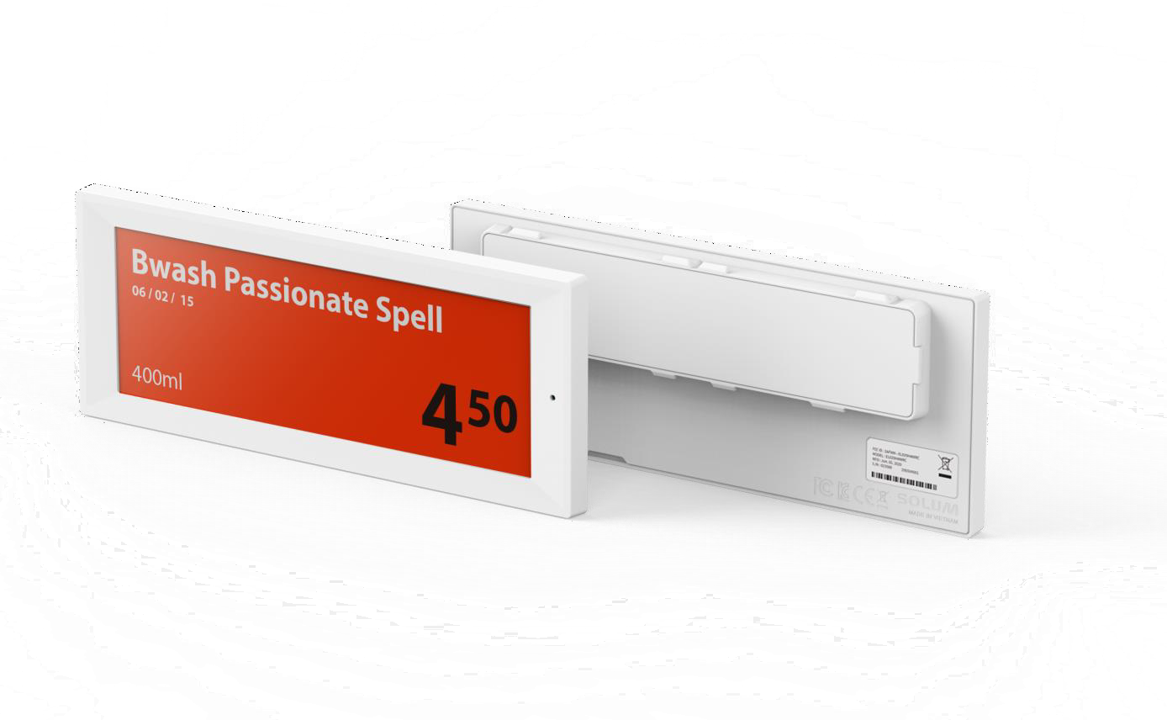
SOLUM RETAIL ESL
PRODUCT LINE-UP
SPECIFICATIONS(11/14)
22
N E W T O N C O R E l 5 . 8 5 I N C H
P R O D U C T S P E C I F I C A T I O N
MODEL | TBD
DIMENSION | 166.27 × 65.78 × 13.30 mm
ACTIVE DISPLAY AREA | 139.0 × 47.7 mm / 5.47 × 1.87 inch
RESOLUTION (Pixel) | 792 × 272
PIXEL DENSITY | 145 dpi
DISPLAY TECHNOLOGY | Full Graphic E-ink Display
BEZEL COLOR | White or Black, Customizable Color(Optional)
PIXEL COLORS | BWR(Black, White, Red)
VIEWING ANGLE | Nearly 180˚
USABLE PAGES | Up to 7 pages
OPERATING TEMPERATURE | 0 ~ 40℃ (32 ~ 104℉)
BATTERY | Battery Pack(CR2450 × 3ea)
BATTERY LIFTIME | Up To 10 years (2 updates/day) ※ 5 years in 0~10 ℃
ENCRYPTION | 128-Bit AES
COMPLIANCE | CE, RoHS, FCC
NFC | FeliCa NFC Forum Type 3
WATERPROOF | N/A
BUTTON | X
LED | 7 Colors (Red/Green/Blue/Yellow/Cyan/Magenta/White)
ESL OPERATING FREQUENCY | 2.4 GHz
WIRELESS FIRMWARE UPDATE | Yes
※ This specification may vary depending on the installation environment and user scenario. This document is subject to change without notice.

Slide 27
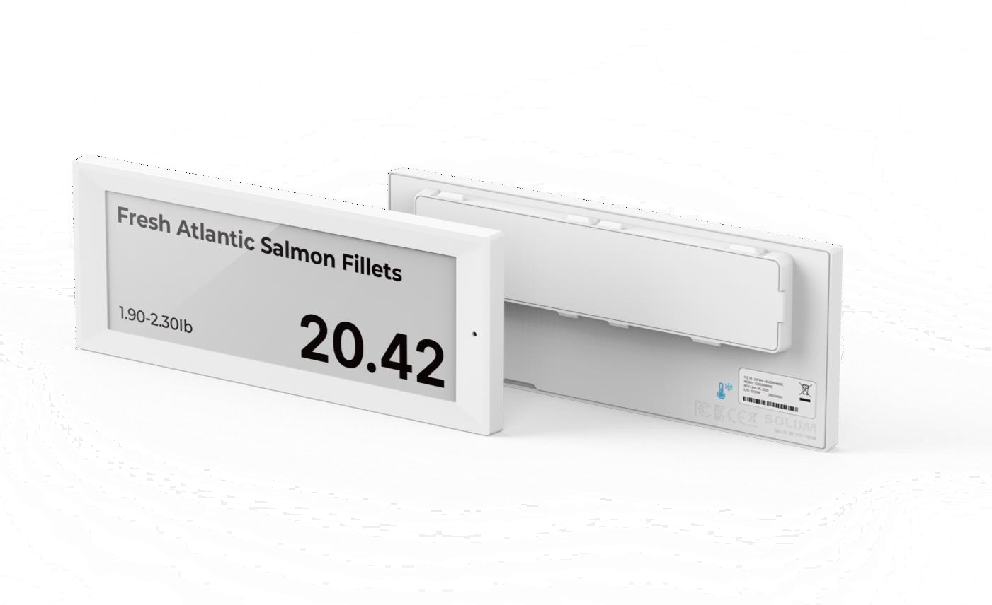
SOLUM RETAIL ESL
PRODUCT LINE-UP
SPECIFICATIONS(12/14)
23
N E W T O N C O R E F R E E Z E R l 5 . 8 5 I N C H
P R O D U C T S P E C I F I C A T I O N
MODEL | TBD
DIMENSION | 166.27 × 65.78 × 13.30 mm
ACTIVE DISPLAY AREA | 139.0 x 47.7 mm / 5.47 x 1.87 inch
RESOLUTION (Pixel) | 792 × 272
PIXEL DENSITY | 145 dpi
DISPLAY TECHNOLOGY | Full Graphic E-ink Display
BEZEL COLOR | White or Black, Customizable Color(Optional)
PIXEL COLORS | BW(Black, White)
VIEWING ANGLE | Nearly 180˚
USABLE PAGES | Up to 7 pages
OPERATING TEMPERATURE | -25 ~ 0℃ (-13 ~ 32℉)
BATTERY | PACK TYPE (CR2450 × 4ea)
BATTERY LIFTIME | Up To 4 years (1 update/day)
ENCRYPTION | 128-Bit AES
COMPLIANCE | CE, RoHS, FCC
NFC | FeliCa NFC Forum Type 3
WATERPROOF | N/A
BUTTON | X
LED | 7 Colors (Red/Green/Blue/Yellow/Cyan/Magenta/White)
ESL OPERATING FREQUENCY | 2.4 GHz
WIRELESS FIRMWARE UPDATE | Yes
※ This specification may vary depending on the installation environment and user scenario. This document is subject to change without notice.

Slide 28

SOLUM RETAIL ESL
PRODUCT LINE-UP
SPECIFICATIONS(13/14)
24
N E W T O N C O R E l 7 . 5 I N C H
P R O D U C T S P E C I F I C A T I O N
MODEL | TBD
DIMENSION | 181.27 × 124.84 × 13.80 mm
ACTIVE DISPLAY AREA | 163.2 × 97.9 mm / 6.40 × 3.80 inch
RESOLUTION (Pixel) | 800 × 480
PIXEL DENSITY | 126 dpi
DISPLAY TECHNOLOGY | Full Graphic E-ink Display
BEZEL COLOR | White or Black, Customizable Color(Optional)
PIXEL COLORS | BWR(Black, White, Red)
VIEWING ANGLE | Nearly 180˚
USABLE PAGES | Up to 3 pages
OPERATING TEMPERATURE | 0 ~ 40℃ (32 ~ 104℉)
BATTERY | Battery Pack(CR2450 × 4ea)
BATTERY LIFTIME | Up To 10 years (2 updates/day) ※ 5 years in 0~10 ℃
ENCRYPTION | 128-Bit AES
COMPLIANCE | CE, RoHS, FCC
NFC | FeliCa NFC Forum Type 3
WATERPROOF | N/A
BUTTON | X
LED | 7 Colors (Red/Green/Blue/Yellow/Cyan/Magenta/White)
ESL OPERATING FREQUENCY | 2.4 GHz
WIRELESS FIRMWARE UPDATE | Yes
※ This specification may vary depending on the installation environment and user scenario. This document is subject to change without notice.

Slide 29
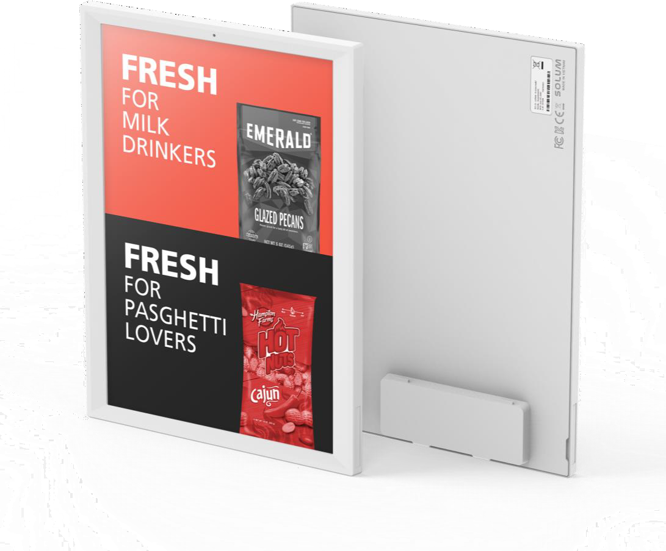
SOLUM RETAIL ESL
PRODUCT LINE-UP
SPECIFICATIONS(14/14)
25
N E W T O N C O R E l 9 . 7 I N C H
P R O D U C T S P E C I F I C A T I O N
MODEL | TBD
DIMENSION | 167.65 × 220.04 × 13.80 mm
ACTIVE DISPLAY AREA | 141.1 × 201.6 mm / 5.55 × 7.93 inch
RESOLUTION (Pixel) | 672 × 960
PIXEL DENSITY | 121 dpi
DISPLAY TECHNOLOGY | Full Graphic E-ink Display
BEZEL COLOR | White or Black, Customizable Color(Optional)
PIXEL COLORS | BWR(Black, White, Red)
VIEWING ANGLE | Nearly 180˚
USABLE PAGES | Up to 7 pages
OPERATING TEMPERATURE | 0 ~ 40℃ (32 ~ 104℉)
BATTERY | Battery Pack(CR2450 × 5ea)
BATTERY LIFTIME | Up To 10 years (2 updates/day) ※ 5 years in 0~10 ℃
ENCRYPTION | 128-Bit AES
COMPLIANCE | CE, RoHS, FCC
NFC | FeliCa NFC Forum Type 3
WATERPROOF | N/A
BUTTON | X
LED | 7 Colors (Red/Green/Blue/Yellow/Cyan/Magenta/White)
ESL OPERATING FREQUENCY | 2.4 GHz
WIRELESS FIRMWARE UPDATE | Yes
※ This specification may vary depending on the installation environment and user scenario. This document is subject to change without notice.

Slide 30

SOLUM RETAIL ESL
PRODUCT LINE-UP
SPECIFICATIONS(12/13)
26
N E W T O N C O R E l 1 1 . 6 I N C H
P R O D U C T S P E C I F I C A T I O N
MODEL | TBD
DIMENSION | 272.37 × 210.00 × 14.20 mm
ACTIVE DISPLAY AREA | 163.0 x 244.5 mm / 6.40 x 9.62 inch
RESOLUTION (Pixel) | 640 x 960
PIXEL DENSITY | 100 dpi
DISPLAY TECHNOLOGY | Full Graphic E-ink Display
BEZEL COLOR | White or Black, Customizable Color(Optional)
PIXEL COLORS | BWR(Black, White, Red)
VIEWING ANGLE | Nearly 180˚
USABLE PAGES | Up to 3 pages
OPERATING TEMPERATURE | 0 ~ 40℃ (32 ~ 104℉)
BATTERY | AA Lithium Battery 4 pcs
BATTERY LIFTIME | Up To 10 years (2 updates/day) ※ 5 years in 0~10 ℃
ENCRYPTION | 128-Bit AES
COMPLIANCE | CE, RoHS, FCC
NFC | FeliCa NFC Forum Type 3
WATERPROOF | N/A
BUTTON | X
LED | 7 Colors (Red/Green/Blue/Yellow/Cyan/Magenta/White)
ESL OPERATING FREQUENCY | 2.4 GHz
WIRELESS FIRMWARE UPDATE | Yes
※ This specification may vary depending on the installation environment and user scenario. This document is subject to change without notice.

Slide 31

SOLUM RETAIL ESL
PRODUCT LINE-UP
SPECIFICATIONS(13/13)
27
N E W T O N C O R E l 1 2 . 2 I N C H
P R O D U C T S P E C I F I C A T I O N
MODEL | TBD
DIMENSION | 261.56 × 215.24 × 14.20 mm
ACTIVE DISPLAY AREA | 190.1 x 237.6 mm / 7.48 x 9.35 inch
RESOLUTION (Pixel) | 768 x 960
PIXEL DENSITY | 103 dpi
DISPLAY TECHNOLOGY | Full Graphic E-ink Display
BEZEL COLOR | White or Black, Customizable Color(Optional)
PIXEL COLORS | BWR(Black, White, Red)
VIEWING ANGLE | Nearly 180˚
USABLE PAGES | Up to 7 pages
OPERATING TEMPERATURE | 0 ~ 40℃ (32 ~ 104℉)
BATTERY | Pack Type (CR2450 × 6ea)
BATTERY LIFTIME | Up To 10 years (2 updates/day) ※ 5 years in 0~10 ℃
ENCRYPTION | 128-Bit AES
COMPLIANCE | CE, RoHS, FCC
NFC | FeliCa NFC Forum Type 3
WATERPROOF | N/A
BUTTON | X
LED | 7 Colors (Red/Green/Blue/Yellow/Cyan/Magenta/White)
ESL OPERATING FREQUENCY | 2.4 GHz
WIRELESS FIRMWARE UPDATE | Yes
※ This specification may vary depending on the installation environment and user scenario. This document is subject to change without notice.

Slide 32
I V. N E W T O N C O R E 4 C O L O R S P E C I F I C A T I O N S

Slide 33
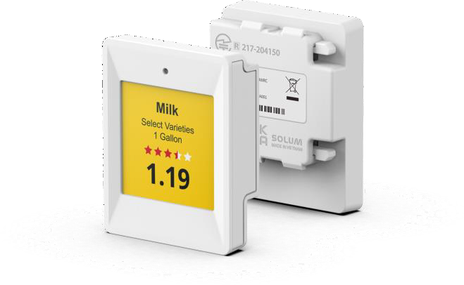
SOLUM RETAIL ESL
PRODUCT LINE-UP
SPECIFICATIONS(1/13)
29
N E W T O N C O R E 4 C O L O R l 1 . 6 I N C H
P R O D U C T S P E C I F I C A T I O N
MODEL | TBD
DIMENSION | 37.08 × 46.75 × 11.52 mm
ACTIVE DISPLAY AREA | 27.0 x 27.0 mm / 1.0 x 1.0 inch
RESOLUTION (Pixel) | 200 x 200
PIXEL DENSITY | 184 dpi
DISPLAY TECHNOLOGY | Full Graphic E-ink Display
BEZEL COLOR | White or Black, Customizable Color(Optional)
PIXEL COLORS | BW / BWR / BWRY
VIEWING ANGLE | Nearly 180˚
USABLE PAGES | Up to 7 pages
OPERATING TEMPERATURE | 0 ~ 40℃ (32 ~ 104℉)
BATTERY | CR2450 × 1ea
BATTERY LIFTIME | Up To 10 years (2 updates/day) ※ 5 years in 0~10 ℃
ENCRYPTION | 128-Bit AES
COMPLIANCE | CE, RoHS, FCC
NFC | FeliCa NFC Forum Type 3
WATERPROOF | N/A
BUTTON | X
LED | 7 Colors (Red/Green/Blue/Yellow/Cyan/Magenta/White)
ESL OPERATING FREQUENCY | 2.4 GHz
WIRELESS FIRMWARE UPDATE | Yes
※ This specification may vary depending on the installation environment and user scenario. This document is subject to change without notice.

Slide 34
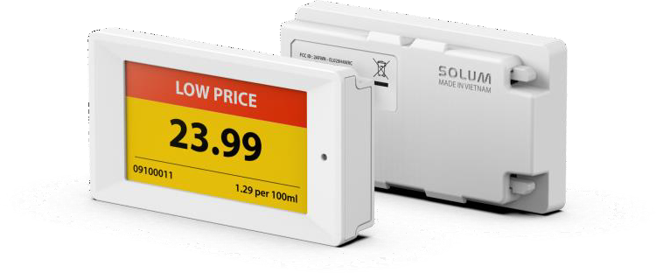
SOLUM RETAIL ESL
PRODUCT LINE-UP
SPECIFICATIONS(2/13)
30
N E W T O N C O R E 4 C O L O R l 2 . 2 I N C H
P R O D U C T S P E C I F I C A T I O N
MODEL | TBD
DIMENSION | 68.05 × 36.95 × 11.52 mm
ACTIVE DISPLAY AREA | 48.1 x 26.0 mm / 1.80 x 1.02 inch
RESOLUTION (Pixel) | 296 x 160
PIXEL DENSITY | 156 dpi
DISPLAY TECHNOLOGY | Full Graphic E-ink Display
BEZEL COLOR | White or Black, Customizable Color(Optional)
PIXEL COLORS | BW / BWR / BWRY
VIEWING ANGLE | Nearly 180˚
USABLE PAGES | Up to 7 pages
OPERATING TEMPERATURE | 0 ~ 40℃ (32 ~ 104℉)
BATTERY | CR2450 × 2ea
BATTERY LIFTIME | Up To 10 years (2 updates/day) ※ 5 years in 0~10 ℃
ENCRYPTION | 128-Bit AES
COMPLIANCE | CE, RoHS, FCC
NFC | FeliCa NFC Forum Type 3
WATERPROOF | N/A
BUTTON | X
LED | 7 Colors (Red/Green/Blue/Yellow/Cyan/Magenta/White)
ESL OPERATING FREQUENCY | 2.4 GHz
WIRELESS FIRMWARE UPDATE | Yes
※ This specification may vary depending on the installation environment and user scenario. This document is subject to change without notice.

Slide 35
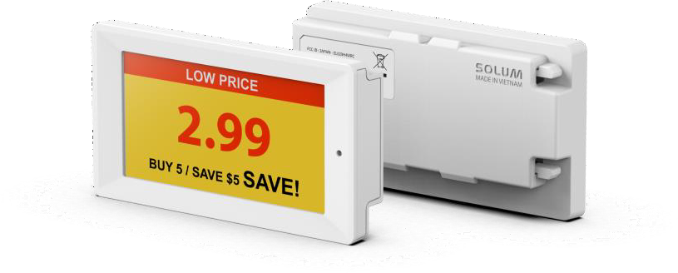
SOLUM RETAIL ESL
PRODUCT LINE-UP
SPECIFICATIONS(3/13)
31
N E W T O N C O R E 4 C O L O R l 2 . 6 I N C H
P R O D U C T S P E C I F I C A T I O N
MODEL | TBD
DIMENSION | 80.14 × 42.79 × 11.52 mm
ACTIVE DISPLAY AREA | 60.1 x 30.7 mm / 2.30 x 1.20 inch
RESOLUTION (Pixel) | 360 x 184
PIXEL DENSITY | 152 dpi
DISPLAY TECHNOLOGY | Full Graphic E-ink Display
BEZEL COLOR | White or Black, Customizable Color(Optional)
PIXEL COLORS | BW / BWR / BWRY
VIEWING ANGLE | Nearly 180˚
USABLE PAGES | Up to 7 pages
OPERATING TEMPERATURE | 0 ~ 40℃ (32 ~ 104℉)
BATTERY | CR2450 × 2ea
BATTERY LIFTIME | Up To 10 years (2 updates/day) ※ 5 years in 0~10 ℃
ENCRYPTION | 128-Bit AES
COMPLIANCE | CE, RoHS, FCC
NFC | FeliCa NFC Forum Type 3
WATERPROOF | N/A
BUTTON | X
LED | 7 Colors (Red/Green/Blue/Yellow/Cyan/Magenta/White)
ESL OPERATING FREQUENCY | 2.4 GHz
WIRELESS FIRMWARE UPDATE | Yes
※ This specification may vary depending on the installation environment and user scenario. This document is subject to change without notice.

Slide 36
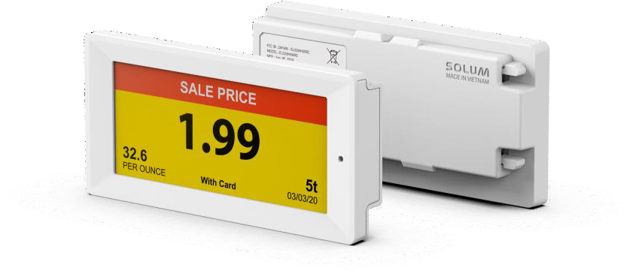
SOLUM RETAIL ESL
PRODUCT LINE-UP
SPECIFICATIONS(4/13)
32
N E W T O N C O R E 4 C O L O R l 2 . 9 I N C H
P R O D U C T S P E C I F I C A T I O N
MODEL | TBD
DIMENSION | 87.33 × 42.79 × 11.52 mm
ACTIVE DISPLAY AREA | 67.6 x 29.6 mm / 2.60 x 1.10 inch
RESOLUTION (Pixel) | 384 x 168
PIXEL DENSITY | 144 dpi
DISPLAY TECHNOLOGY | Full Graphic E-ink Display
BEZEL COLOR | White or Black, Customizable Color(Optional)
PIXEL COLORS | BW / BWR / BWRY
VIEWING ANGLE | Nearly 180˚
USABLE PAGES | Up to 7 pages
OPERATING TEMPERATURE | 0 ~ 40℃ (32 ~ 104℉)
BATTERY | CR2450 × 2ea
BATTERY LIFTIME | Up To 10 years (2 updates/day) ※ 5 years in 0~10 ℃
ENCRYPTION | 128-Bit AES
COMPLIANCE | CE, RoHS, FCC
NFC | FeliCa NFC Forum Type 3
WATERPROOF | N/A
BUTTON | X
LED | 7 Colors (Red/Green/Blue/Yellow/Cyan/Magenta/White)
ESL OPERATING FREQUENCY | 2.4 GHz
WIRELESS FIRMWARE UPDATE | Yes
※ This specification may vary depending on the installation environment and user scenario. This document is subject to change without notice.

Slide 37
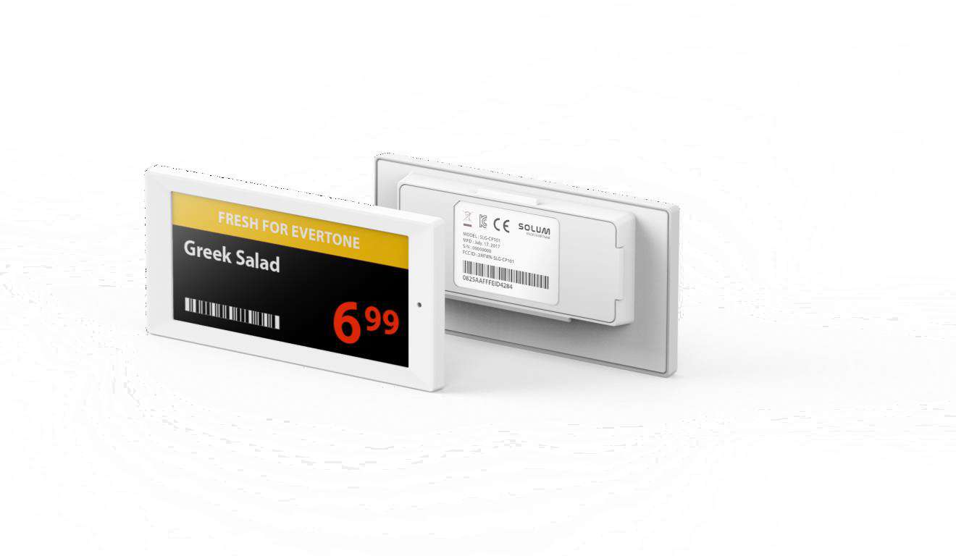
SOLUM RETAIL ESL
PRODUCT LINE-UP
SPECIFICATIONS(5/13)
33
N E W T O N C O R E 4 C O L O R l 3 . 5 2 I N C H
P R O D U C T S P E C I F I C A T I O N
MODEL | TBD
DIMENSION | 99.58 × 49.19 × 11.52 mm
ACTIVE DISPLAY AREA | 81.0 x 37.9 mm / 3.10 x 1.50 inch
RESOLUTION (Pixel) | 384 x 180
PIXEL DENSITY | 120 dpi
DISPLAY TECHNOLOGY | Full Graphic E-ink Display
BEZEL COLOR | White or Black, Customizable Color(Optional)
PIXEL COLORS | BW / BWR / BWRY
VIEWING ANGLE | Nearly 180˚
USABLE PAGES | Up to 7 pages
OPERATING TEMPERATURE | 0 ~ 40℃ (32 ~ 104℉)
BATTERY | CR2450 × 2ea
BATTERY LIFTIME | Up To 10 years (2 updates/day) ※ 5 years in 0~10 ℃
ENCRYPTION | 128-Bit AES
COMPLIANCE | CE, RoHS, FCC
NFC | FeliCa NFC Forum Type 3
WATERPROOF | N/A
BUTTON | X
LED | 7 Colors (Red/Green/Blue/Yellow/Cyan/Magenta/White)
ESL OPERATING FREQUENCY | 2.4 GHz
WIRELESS FIRMWARE UPDATE | Yes
※ This specification may vary depending on the installation environment and user scenario. This document is subject to change without notice.

Slide 38
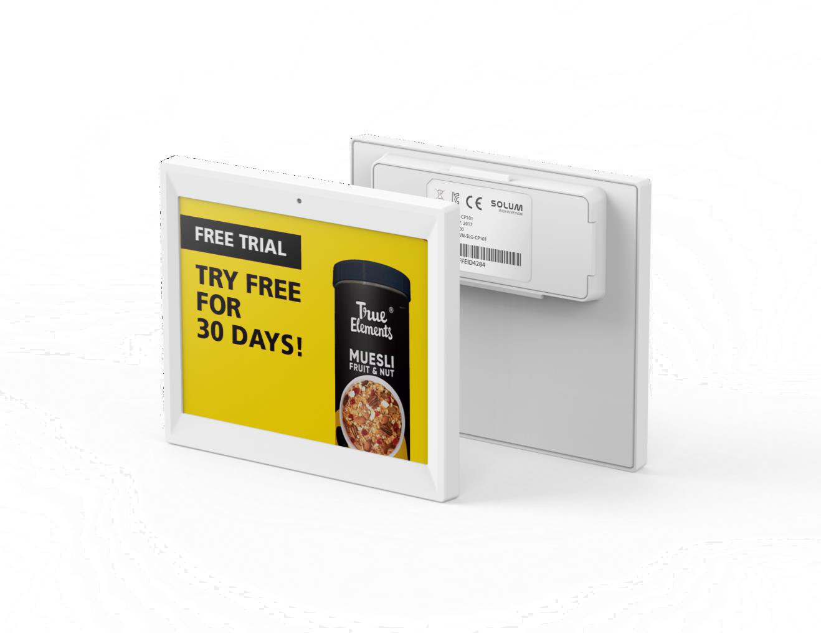
SOLUM RETAIL ESL
PRODUCT LINE-UP
SPECIFICATIONS(6/13)
34
N E W T O N C O R E 4 C O L O R l 4 . 2 I N C H
P R O D U C T S P E C I F I C A T I O N
MODEL | TBD
DIMENSION | 97.92 × 83.65 × 13.30 mm
ACTIVE DISPLAY AREA | 84.8 x 63.6 mm / 3.30 x 2.50 inch
RESOLUTION (Pixel) | 400 x 300
PIXEL DENSITY | 120 dpi
DISPLAY TECHNOLOGY | Full Graphic E-ink Display
BEZEL COLOR | White or Black, Customizable Color(Optional)
PIXEL COLORS | BW / BWR / BWRY
VIEWING ANGLE | Nearly 180˚
USABLE PAGES | Up to 7 pages
OPERATING TEMPERATURE | 0 ~ 40℃ (32 ~ 104℉)
BATTERY | Pack Type (CR2450 × 2ea)
BATTERY LIFTIME | Up To 10 years (2 updates/day) ※ 5 years in 0~10 ℃
ENCRYPTION | 128-Bit AES
COMPLIANCE | CE, RoHS, FCC
NFC | FeliCa NFC Forum Type 3
WATERPROOF | N/A
BUTTON | X
LED | 7 Colors (Red/Green/Blue/Yellow/Cyan/Magenta/White)
ESL OPERATING FREQUENCY | 2.4 GHz
WIRELESS FIRMWARE UPDATE | Yes
※ This specification may vary depending on the installation environment and user scenario. This document is subject to change without notice.

Slide 39
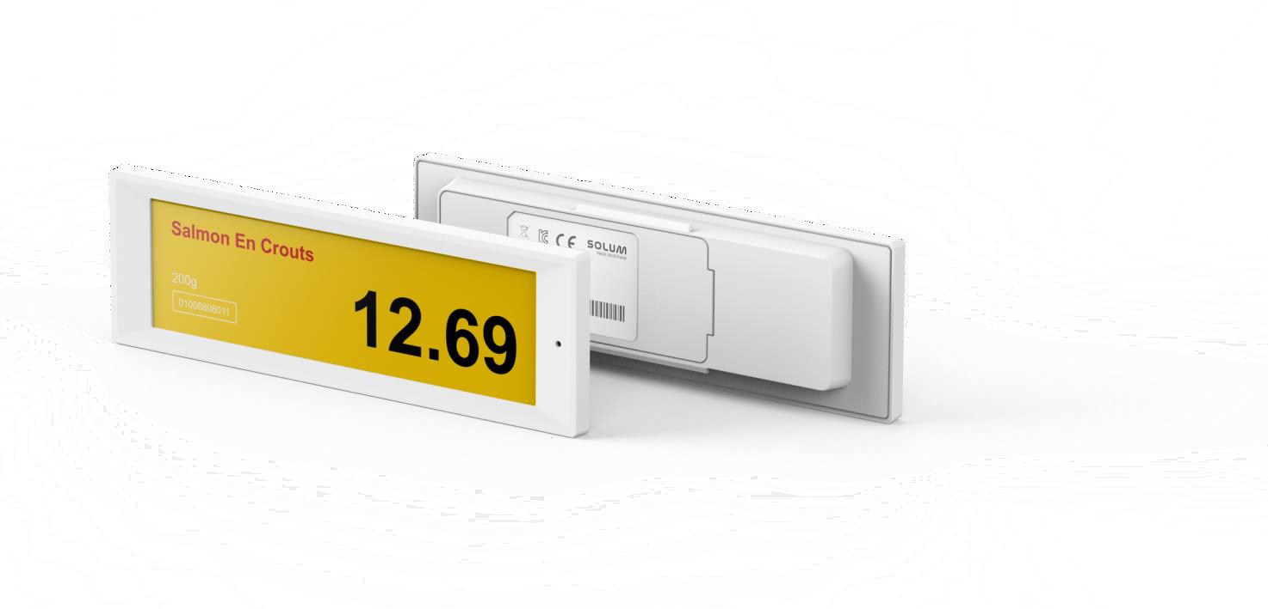
SOLUM RETAIL ESL
PRODUCT LINE-UP
SPECIFICATIONS(7/13)
35
N E W T O N C O R E 4 C O L O R l 4 . 3 I N C H
P R O D U C T S P E C I F I C A T I O N
MODEL | TBD
DIMENSION | 128.62 × 41.94 × 12.15 mm
ACTIVE DISPLAY AREA | 105.4 x 30.7mm / 4.14 x 1.20 inch
RESOLUTION (Pixel) | 522 x 152
PIXEL DENSITY | 125 dpi
DISPLAY TECHNOLOGY | Full Graphic E-ink Display
BEZEL COLOR | White or Black, Customizable Color(Optional)
PIXEL COLORS | BW / BWR / BWRY
VIEWING ANGLE | Nearly 180˚
USABLE PAGES | Up to 7 pages
OPERATING TEMPERATURE | 0 ~ 40℃ (32 ~ 104℉)
BATTERY | Pack Type (CR2450 × 3ea)
BATTERY LIFTIME | Up To 10 years (2 updates/day) ※ 5 years in 0~10 ℃
ENCRYPTION | 128-Bit AES
COMPLIANCE | CE, RoHS, FCC
NFC | FeliCa NFC Forum Type 3
WATERPROOF | N/A
BUTTON | X
LED | 7 Colors (Red/Green/Blue/Yellow/Cyan/Magenta/White)
ESL OPERATING FREQUENCY | 2.4 GHz
WIRELESS FIRMWARE UPDATE | Yes
※ This specification may vary depending on the installation environment and user scenario. This document is subject to change without notice.

Slide 40
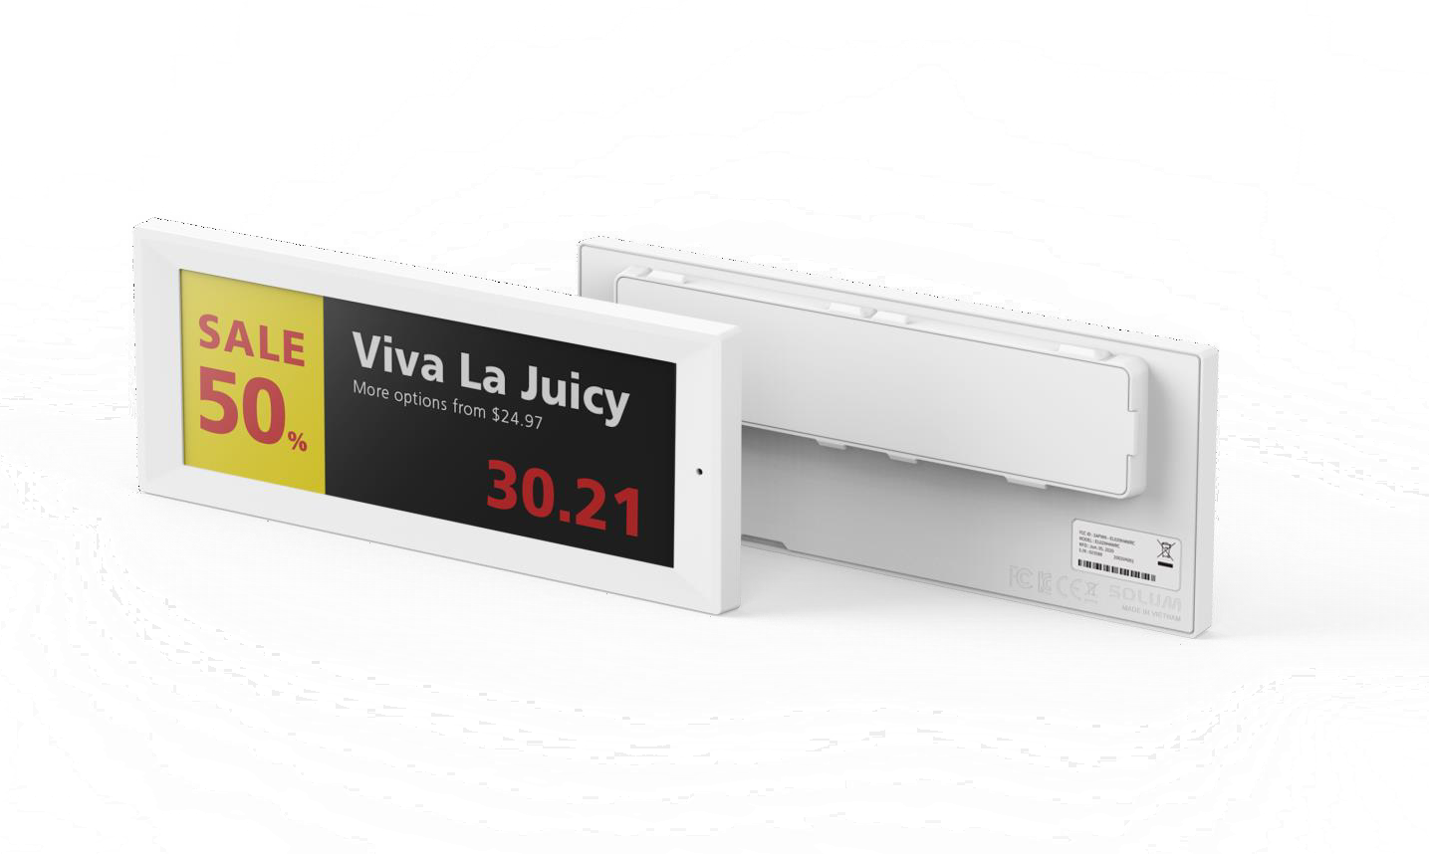
SOLUM RETAIL ESL
PRODUCT LINE-UP
SPECIFICATIONS(8/13)
36
N E W T O N C O R E 4 C O L O R l 5 . 8 5 I N C H
P R O D U C T S P E C I F I C A T I O N
MODEL | TBD
DIMENSION | 166.27 × 65.78 × 13.30 mm
ACTIVE DISPLAY AREA | 139.0 × 47.7 mm / 5.47 × 1.87 inch
RESOLUTION (Pixel) | 792 x 272
PIXEL DENSITY | 145 dpi
DISPLAY TECHNOLOGY | Full Graphic E-ink Display
BEZEL COLOR | White or Black, Customizable Color(Optional)
PIXEL COLORS | BW / BWR / BWRY
VIEWING ANGLE | Nearly 180˚
USABLE PAGES | Up to 7 pages
OPERATING TEMPERATURE | 0 ~ 40℃ (32 ~ 104℉)
BATTERY | Pack Type (CR2450 × 3ea)
BATTERY LIFTIME | Up To 10 years (2 updates/day) ※ 5 years in 0~10 ℃
ENCRYPTION | 128-Bit AES
COMPLIANCE | CE, RoHS, FCC
NFC | FeliCa NFC Forum Type 3
WATERPROOF | N/A
BUTTON | X
LED | 7 Colors (Red/Green/Blue/Yellow/Cyan/Magenta/White)
ESL OPERATING FREQUENCY | 2.4 GHz
WIRELESS FIRMWARE UPDATE | Yes
※ This specification may vary depending on the installation environment and user scenario. This document is subject to change without notice.

Slide 41
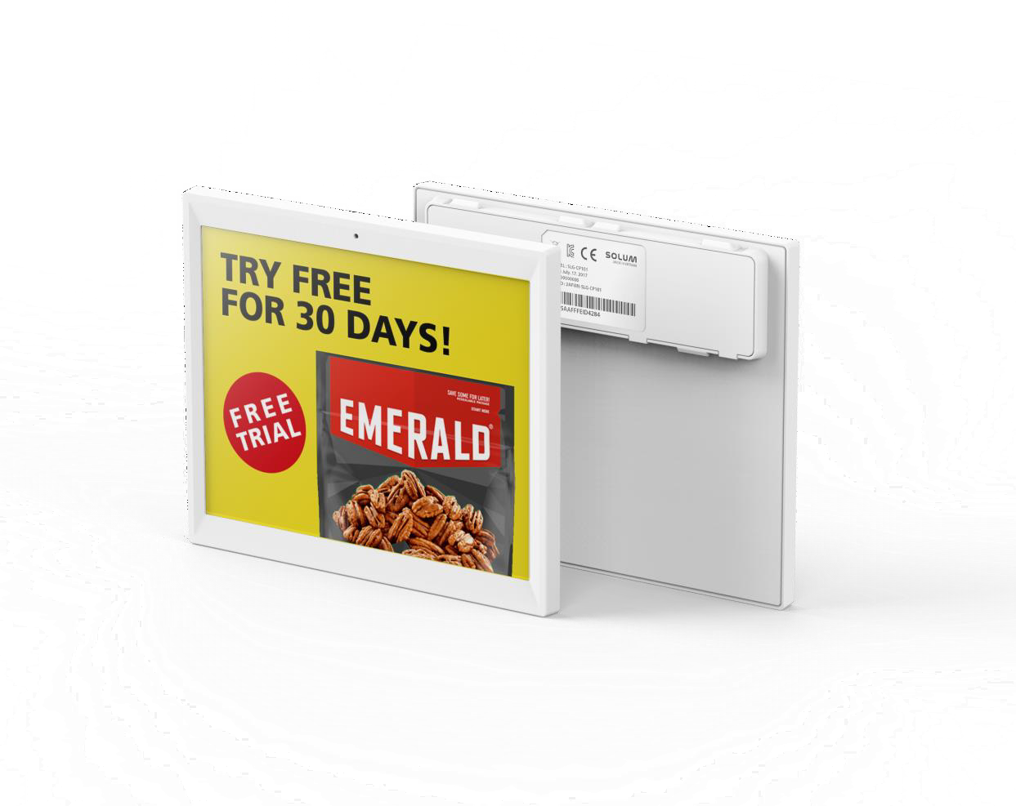
SOLUM RETAIL ESL
PRODUCT LINE-UP
SPECIFICATIONS(9/13)
37
N E W T O N C O R E 4 C O L O R l 6 . 0 I N C H
P R O D U C T S P E C I F I C A T I O N
MODEL | TBD
DIMENSION | TBD
ACTIVE DISPLAY AREA | 114.9 × 85.8 mm / 4.52 × 3.37 inch
RESOLUTION (Pixel) | 600 x 448
PIXEL DENSITY | 132 dpi
DISPLAY TECHNOLOGY | Full Graphic E-ink Display
BEZEL COLOR | White or Black, Customizable Color(Optional)
PIXEL COLORS | BW / BWR / BWRY
VIEWING ANGLE | Nearly 180˚
USABLE PAGES | Up to 3 pages
OPERATING TEMPERATURE | 0 ~ 40℃ (32 ~ 104℉)
BATTERY | TBD
BATTERY LIFTIME | Up To 10 years (2 updates/day) ※ 5 years in 0~10 ℃
ENCRYPTION | 128-Bit AES
COMPLIANCE | CE, RoHS, FCC
NFC | FeliCa NFC Forum Type 3
WATERPROOF | N/A
BUTTON | X
LED | 7 Colors (Red/Green/Blue/Yellow/Cyan/Magenta/White)
ESL OPERATING FREQUENCY | 2.4 GHz
WIRELESS FIRMWARE UPDATE | Yes
※ This specification may vary depending on the installation environment and user scenario. This document is subject to change without notice.

Slide 42

SOLUM RETAIL ESL
PRODUCT LINE-UP
SPECIFICATIONS(10/13)
38
N E W T O N C O R E 4 C O L O R l 7 . 5 I N C H
P R O D U C T S P E C I F I C A T I O N
MODEL | TBD
DIMENSION | 181.27 × 124.84 × 13.80 mm
ACTIVE DISPLAY AREA | 163.2 x 97.9 mm / 6.40 x 3.80 inch
RESOLUTION (Pixel) | 800 x 480
PIXEL DENSITY | 126 dpi
DISPLAY TECHNOLOGY | Full Graphic E-ink Display
BEZEL COLOR | White or Black, Customizable Color(Optional)
PIXEL COLORS | BW / BWR / BWRY
VIEWING ANGLE | Nearly 180˚
USABLE PAGES | Up to 3 pages
OPERATING TEMPERATURE | 0 ~ 40℃ (32 ~ 104℉)
BATTERY | Pack Type (CR2450 × 4ea)
BATTERY LIFTIME | Up To 10 years (2 updates/day) ※ 5 years in 0~10 ℃
ENCRYPTION | 128-Bit AES
COMPLIANCE | CE, RoHS, FCC
NFC | FeliCa NFC Forum Type 3
WATERPROOF | N/A
BUTTON | X
LED | 7 Colors (Red/Green/Blue/Yellow/Cyan/Magenta/White)
ESL OPERATING FREQUENCY | 2.4 GHz
WIRELESS FIRMWARE UPDATE | Yes
※ This specification may vary depending on the installation environment and user scenario. This document is subject to change without notice.

Slide 43
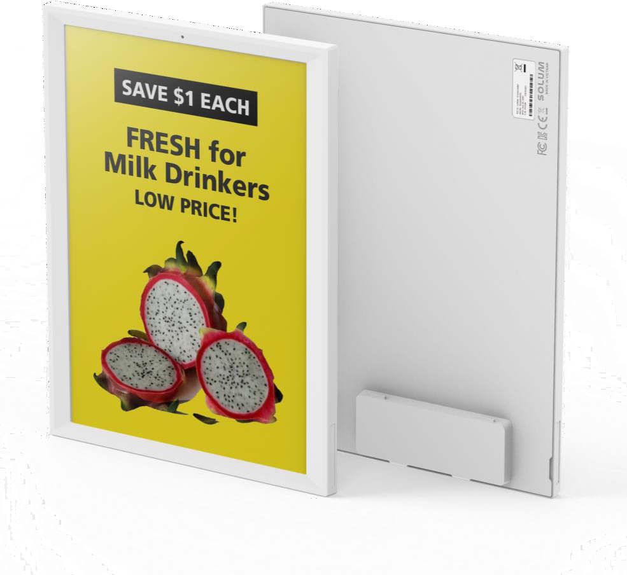
SOLUM RETAIL ESL
PRODUCT LINE-UP
SPECIFICATIONS(11/13)
39
N E W T O N C O R E 4 C O L O R l 9 . 7 I N C H
P R O D U C T S P E C I F I C A T I O N
MODEL | TBD
DIMENSION | 167.65 × 220.04 × 13.80 mm
ACTIVE DISPLAY AREA | 141.1 x 201.6 mm / 5.55 x 7.93 inch
RESOLUTION (Pixel) | 672 x 960
PIXEL DENSITY | 121 dpi
DISPLAY TECHNOLOGY | Full Graphic E-ink Display
BEZEL COLOR | White or Black, Customizable Color(Optional)
PIXEL COLORS | BW / BWR / BWRY
VIEWING ANGLE | Nearly 180˚
USABLE PAGES | Up to 7 pages
OPERATING TEMPERATURE | 0 ~ 40℃ (32 ~ 104℉)
BATTERY | Pack Type (CR2450 × 5ea)
BATTERY LIFTIME | Up To 10 years (2 updates/day) ※ 5 years in 0~10 ℃
ENCRYPTION | 128-Bit AES
COMPLIANCE | CE, RoHS, FCC
NFC | FeliCa NFC Forum Type 3
WATERPROOF | N/A
BUTTON | X
LED | 7 Colors (Red/Green/Blue/Yellow/Cyan/Magenta/White)
ESL OPERATING FREQUENCY | 2.4 GHz
WIRELESS FIRMWARE UPDATE | Yes
※ This specification may vary depending on the installation environment and user scenario. This document is subject to change without notice.

Slide 44
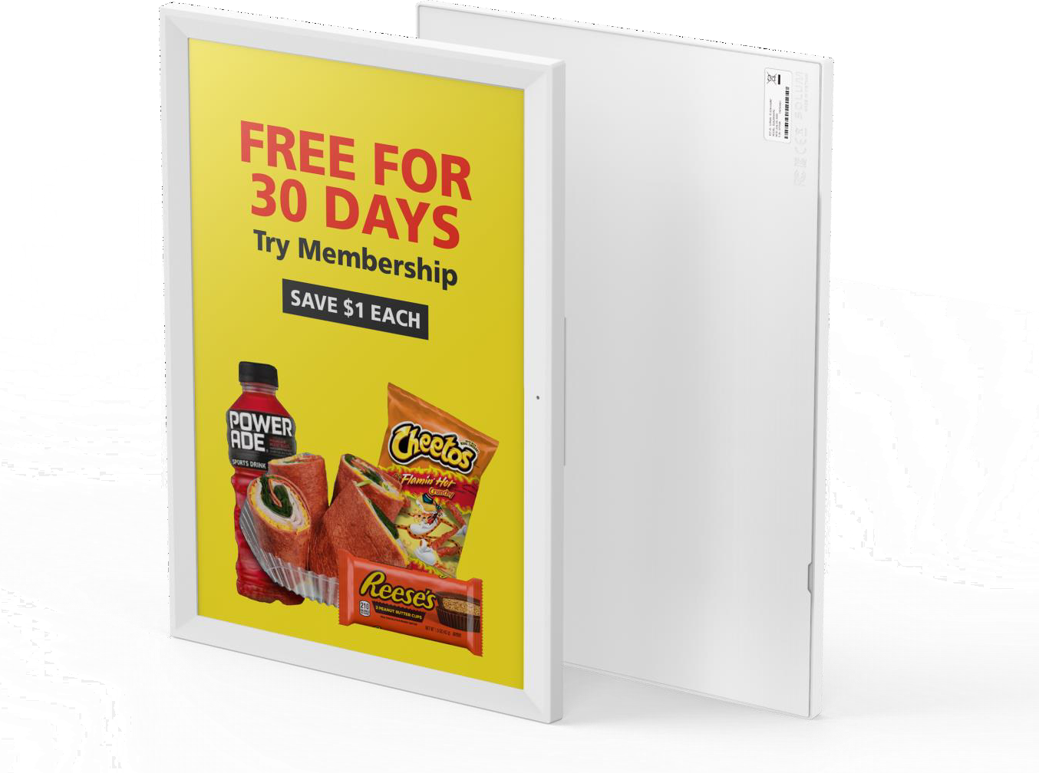
SOLUM RETAIL ESL
PRODUCT LINE-UP
SPECIFICATIONS(12/13)
40
N E W T O N C O R E 4 C O L O R l 1 1 . 6 I N C H
P R O D U C T S P E C I F I C A T I O N
MODEL | TBD
DIMENSION | 272.37 × 210.00 × 14.20 mm
ACTIVE DISPLAY AREA | 163.0 x 244.5 mm / 6.40 x 9.62 inch
RESOLUTION (Pixel) | 640 x 960
PIXEL DENSITY | 100 dpi
DISPLAY TECHNOLOGY | Full Graphic E-ink Display
BEZEL COLOR | White or Black, Customizable Color(Optional)
PIXEL COLORS | BW / BWR / BWRY
VIEWING ANGLE | Nearly 180˚
USABLE PAGES | Up to 3 pages
OPERATING TEMPERATURE | 0 ~ 40℃ (32 ~ 104℉)
BATTERY | AA Lithium Battery 4 pcs
BATTERY LIFTIME | Up To 10 years (2 updates/day) ※ 5 years in 0~10 ℃
ENCRYPTION | 128-Bit AES
COMPLIANCE | CE, RoHS, FCC
NFC | FeliCa NFC Forum Type 3
WATERPROOF | N/A
BUTTON | X
LED | 7 Colors (Red/Green/Blue/Yellow/Cyan/Magenta/White)
ESL OPERATING FREQUENCY | 2.4 GHz
WIRELESS FIRMWARE UPDATE | Yes
※ This specification may vary depending on the installation environment and user scenario. This document is subject to change without notice.

Slide 45

SOLUM RETAIL ESL
PRODUCT LINE-UP
SPECIFICATIONS(13/13)
41
N E W T O N C O R E 4 C O L O R l 1 2 . 2 I N C H
P R O D U C T S P E C I F I C A T I O N
MODEL | TBD
DIMENSION | 261.56 × 215.24 × 14.20 mm
ACTIVE DISPLAY AREA | 190.1 x 237.6 mm / 7.48 x 9.35 inch
RESOLUTION (Pixel) | 768 x 960
PIXEL DENSITY | 103 dpi
DISPLAY TECHNOLOGY | Full Graphic E-ink Display
BEZEL COLOR | White or Black, Customizable Color(Optional)
PIXEL COLORS | BW / BWR / BWRY
VIEWING ANGLE | Nearly 180˚
USABLE PAGES | Up to 7 pages
OPERATING TEMPERATURE | 0 ~ 40℃ (32 ~ 104℉)
BATTERY | Pack Type (CR2450 × 6ea)
BATTERY LIFTIME | Up To 10 years (2 updates/day) ※ 5 years in 0~10 ℃
ENCRYPTION | 128-Bit AES
COMPLIANCE | CE, RoHS, FCC
NFC | FeliCa NFC Forum Type 3
WATERPROOF | N/A
BUTTON | X
LED | 7 Colors (Red/Green/Blue/Yellow/Cyan/Magenta/White)
ESL OPERATING FREQUENCY | 2.4 GHz
WIRELESS FIRMWARE UPDATE | Yes
※ This specification may vary depending on the installation environment and user scenario. This document is subject to change without notice.

Slide 46
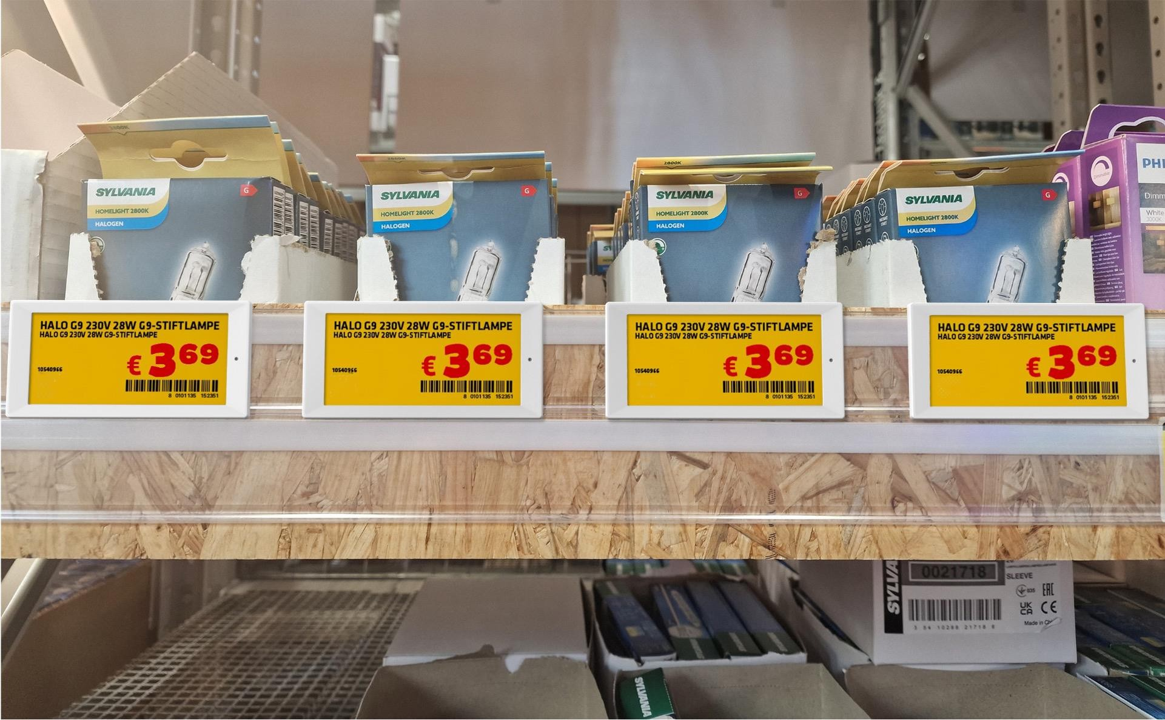

NEWTON Line-up
N E W T O N C O R E 3 . 5 2 ” B W R Y l A P P L I C A T I O N

Slide 47
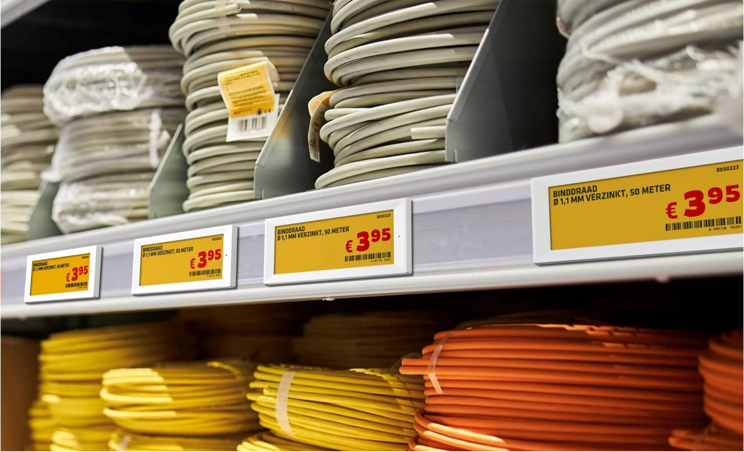
NEWTON Line-up
N E W T O N C O R E 5 . 8 5 ” B W R Y l A P P L I C A T I O N

Slide 48
THAN K YOU VE RY M U C H FOR YOU R AT TE N T ION !

